Slide 1
Liceo Scientifico “N. Sensale”
Nocera Inferiore, Italia

Slide 2
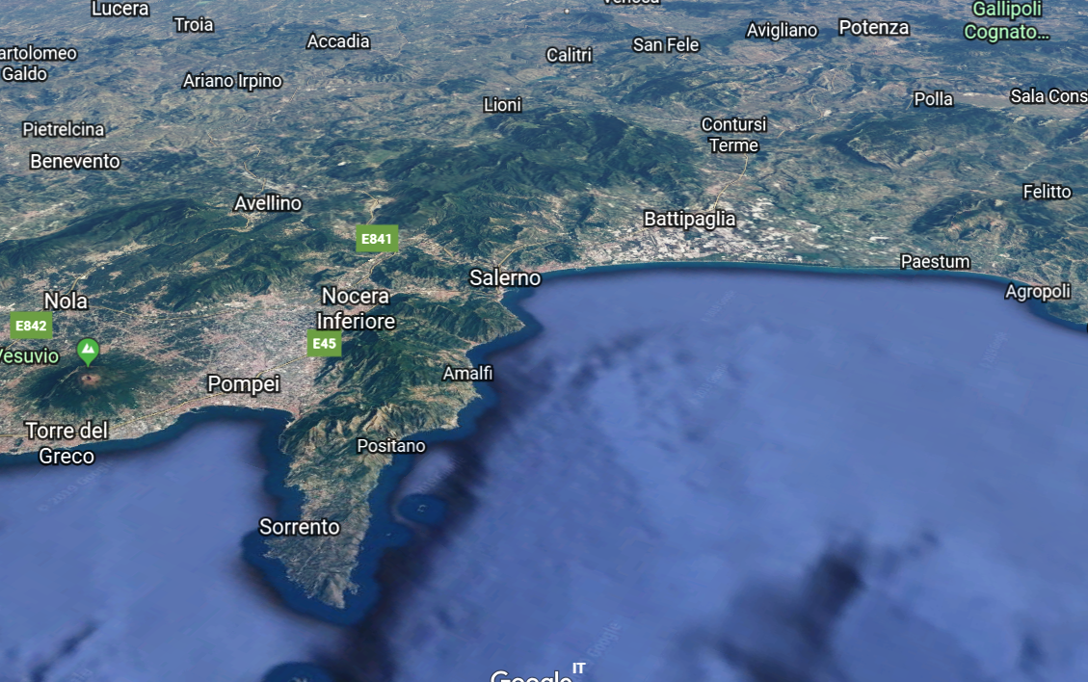
History of Nocera Inferiore
Nocera Inferiore
Location: It is in the south of Italy between the cities of Salerno
and Pompeii, about 20 minutes from the Amalfi coast
45.796 inhabitants
Its ancient name was Nuvkrinum Alafaternum (Nuceria Alfaterna or Νουκερία)
It is believed that the city was founded 750 years before the birth of Rome, that is in 1503 BC.
Originally the city was an Etruscan settlement like Capua, Nola and Pompeii .
According to Plinius the Elder Nocera lay along the Sarno River, nine miles from its mouth and
16 miles south-east of Nola. In reality, the river was quite far from the city, but the water
supply for the settlement was ensured by the neighboring Cavaiola stream and by many
other rivers on Mount Montalbino.
Nowadays its predominant economic activity is connected to San Marzano tomato, which implies its growing, processing and preservation. It is a high quality product which has received the EU label PDO (Protected Designation of Origin).

Slide 3
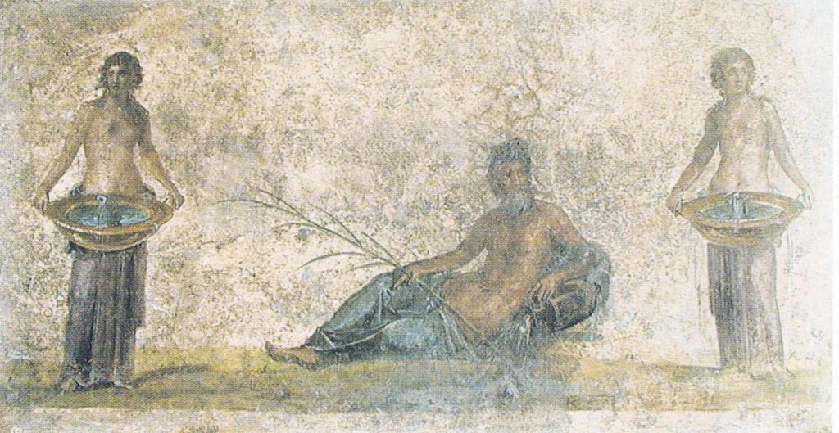
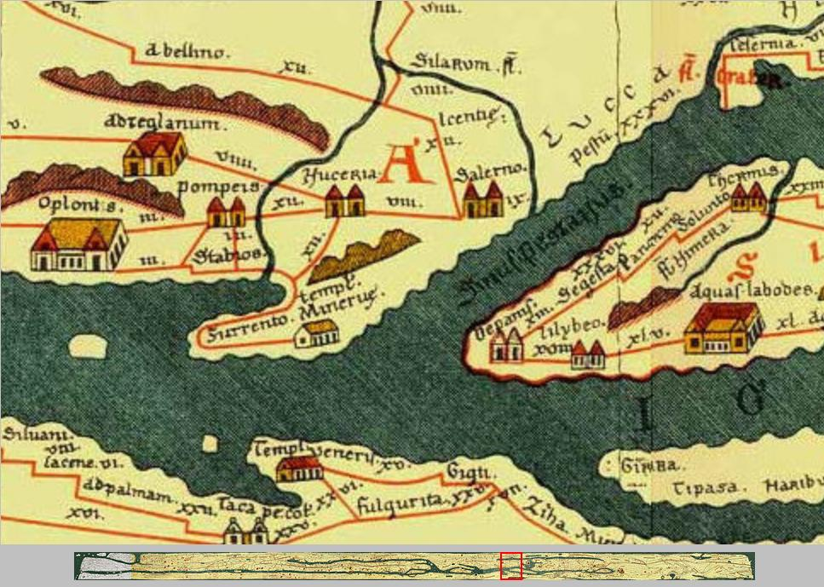
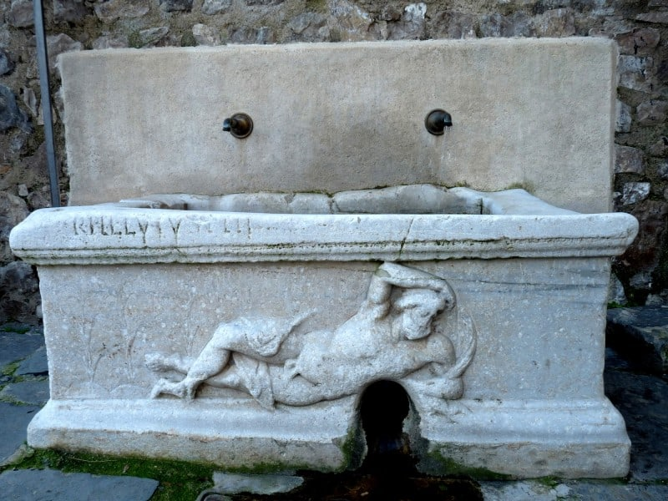
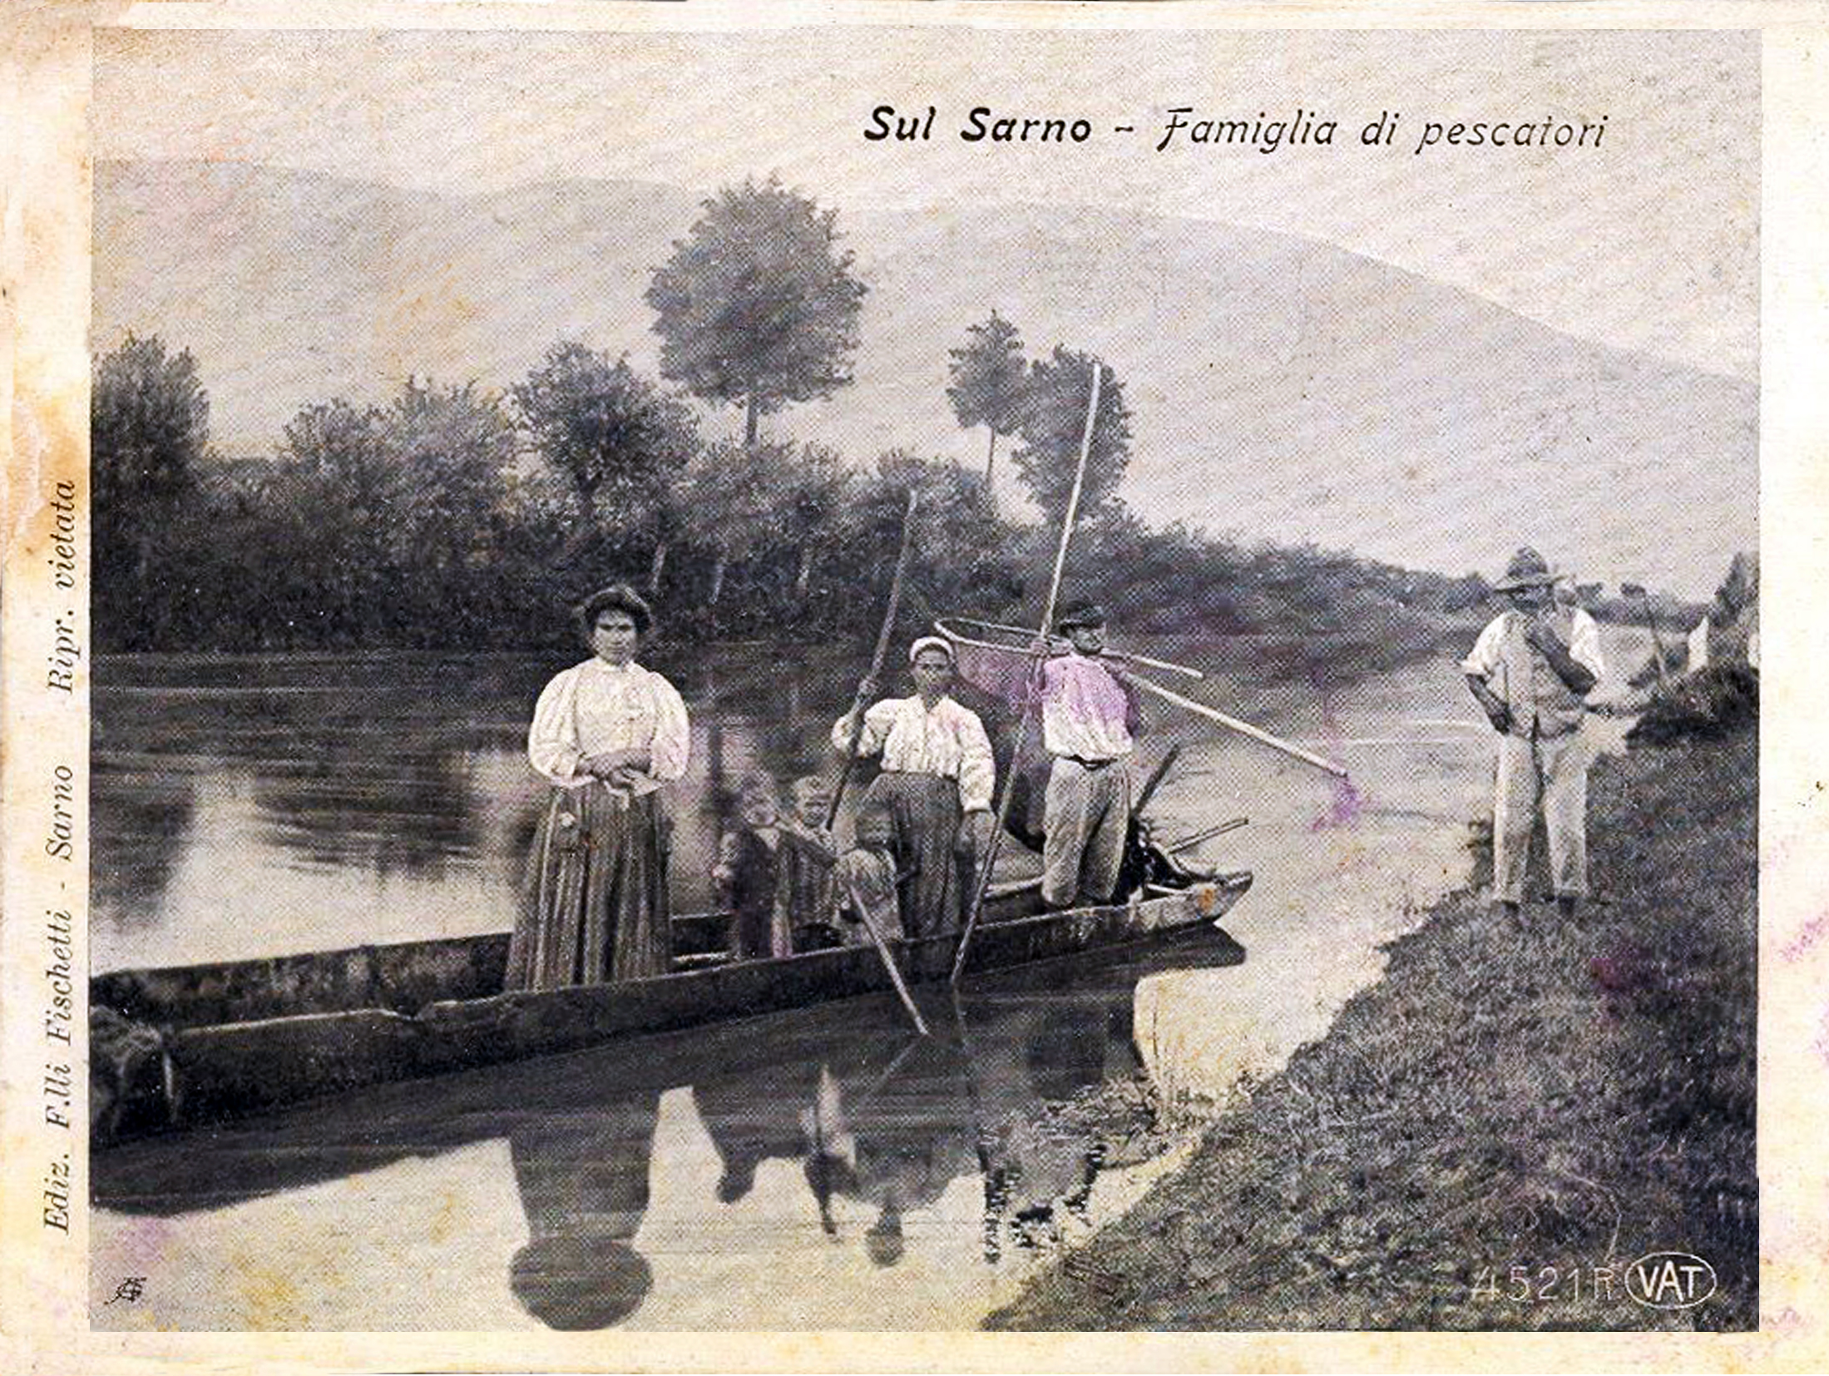
Meet our Sarno river
The Sarno river portrayed as a God in this ancient fresco.

Slide 4
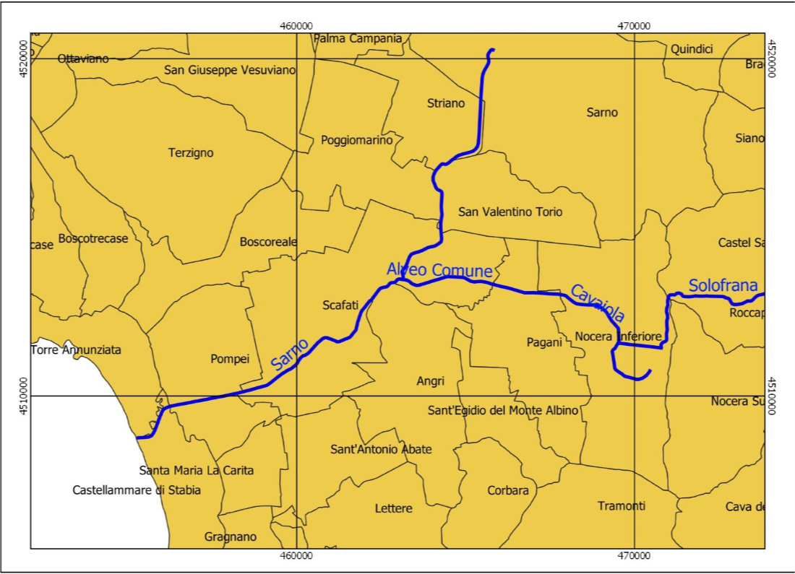
Watch a video about the journey of the Sarno river from its source to its mouth
As you can see the river Sarno flows through country and city areas.
When it goes through country landscapes its water is drunk by the people and used to irrigate fields.
Unfortunately, when it goes through densely populated cities like Scafati,
Pompeii and Castellammare di Stabia it gets very polluted as the dark colour of its mouth shows.
A part of the river is covered in some towns and cities like Mercato S. Severino, Cava De’ Tirreni and Nocera Inferiore

Slide 5
Issues of Sarno river
Some of the main issues concerning our river are:
Pollution - The river becomes particularly polluted in Scafati, where its tributary the river Solofrana, which carries waste water from leather industries, flows into it.
Floods - in Nocera Inferiore the river floods in many areas because of an incorrect maintenance of its river bed
Built interventions - the river flows through very big urban areas, in some places the watercourse has been culverted
Threats from human activities - The river is polluted because wastewater from leather industries in Solofra, from tomato processing industries and from urban areas is discharged into it

Slide 6
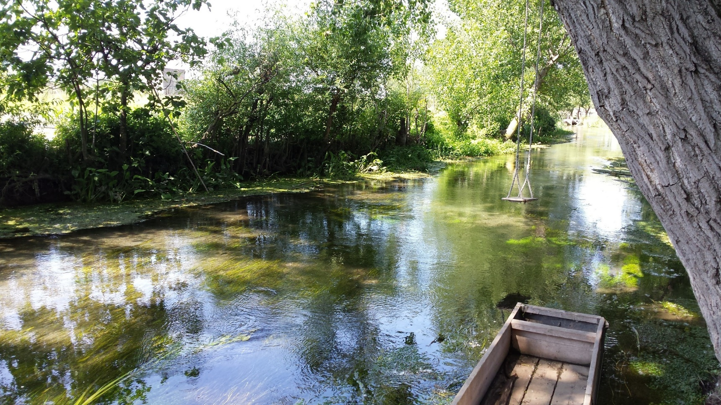
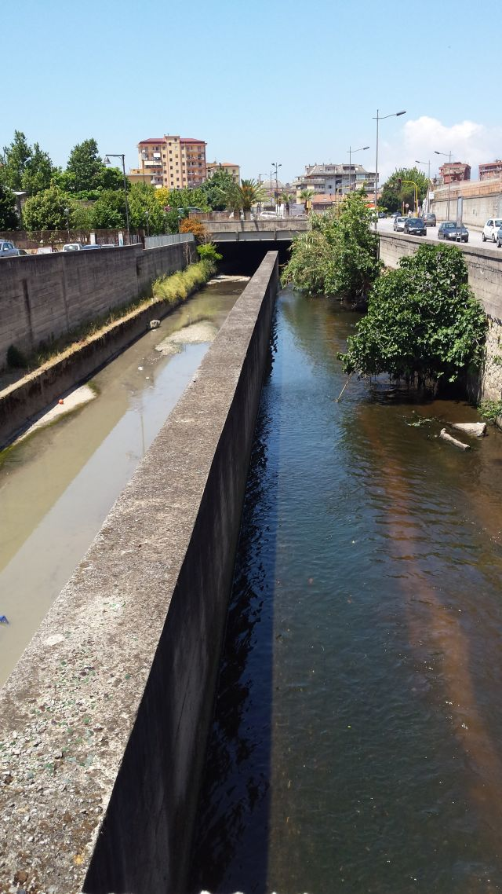
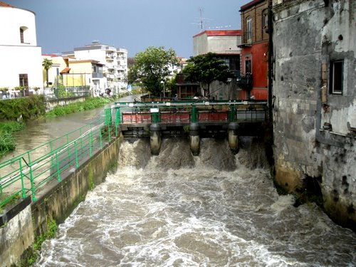
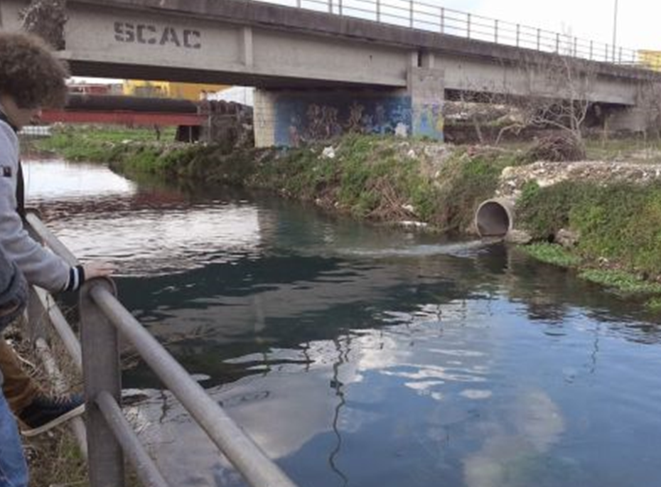
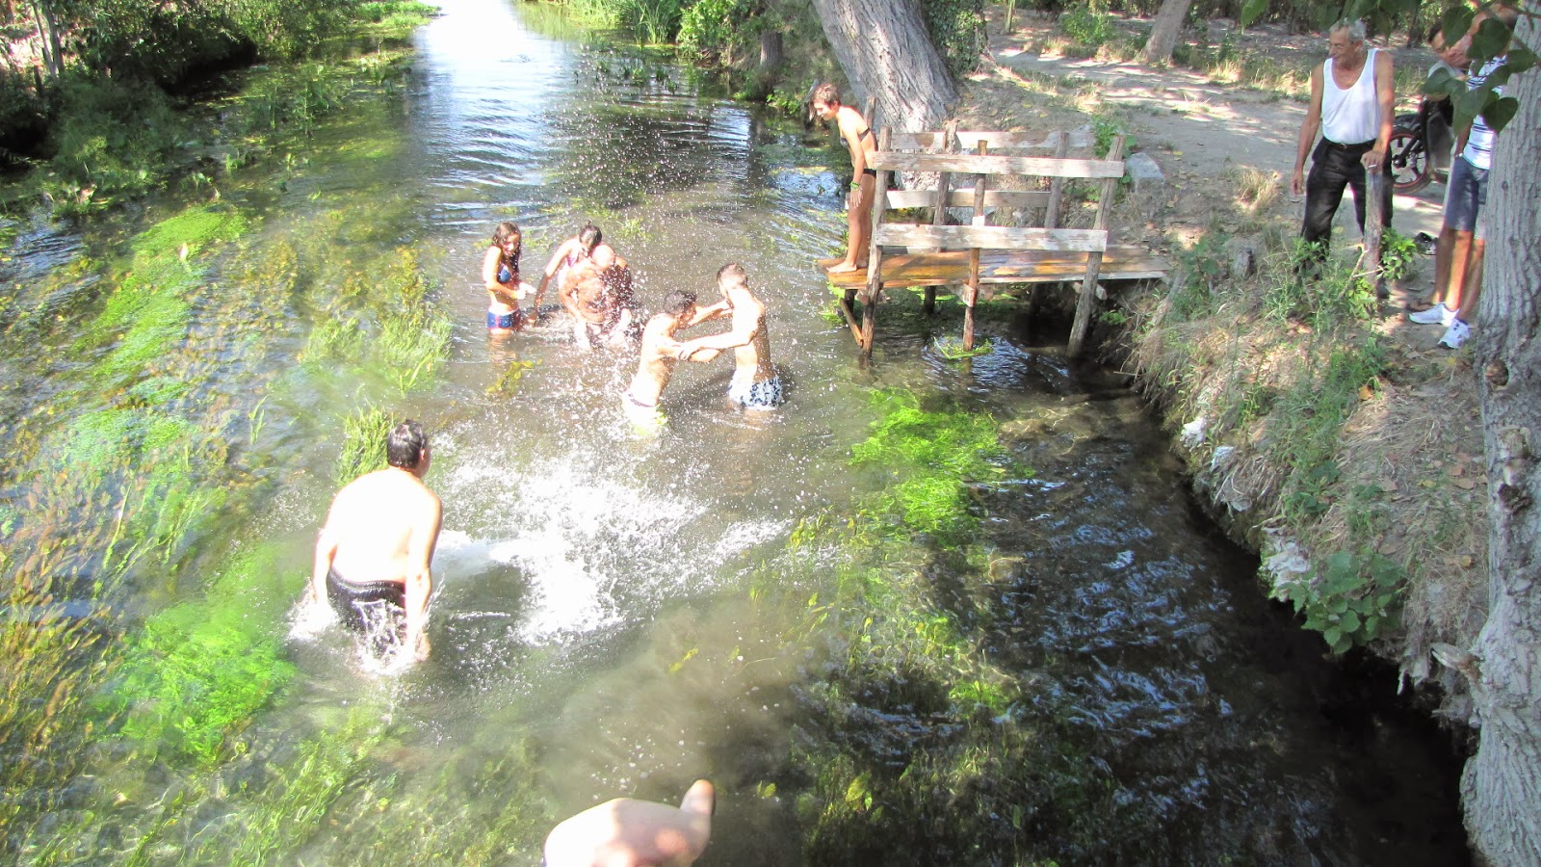
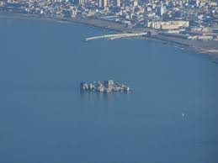

Slide 7
Thank you
Grazie
Ευχαριστούμε
Gracias
Teşekkür ederim

