Slide 1
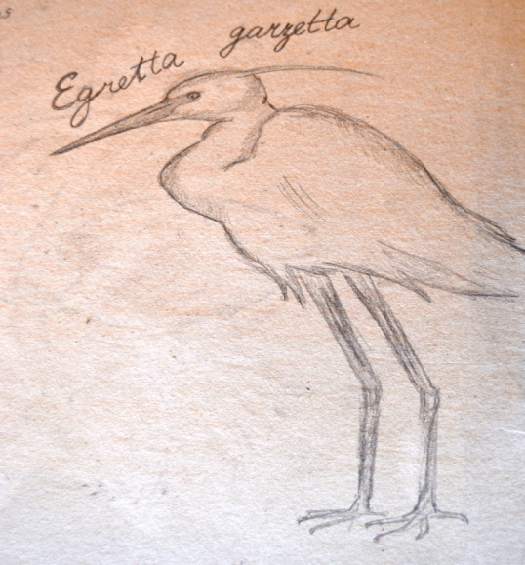
1st General Lyceum of Rafina
Rafina, Greece

Slide 3
Rafina, Attica, Greece

Slide 4
Photografic Achive of Mr Stathis Dimitrakos

Slide 5
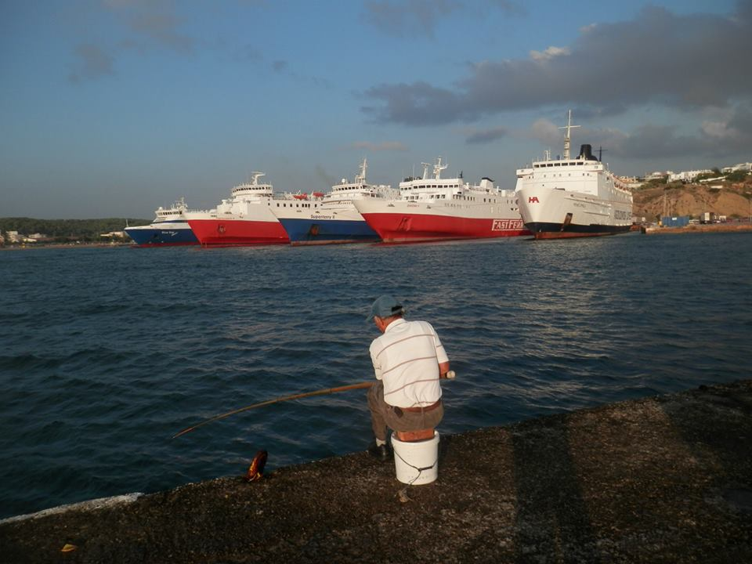
The gigantization of the Port is the biggest

Slide 6
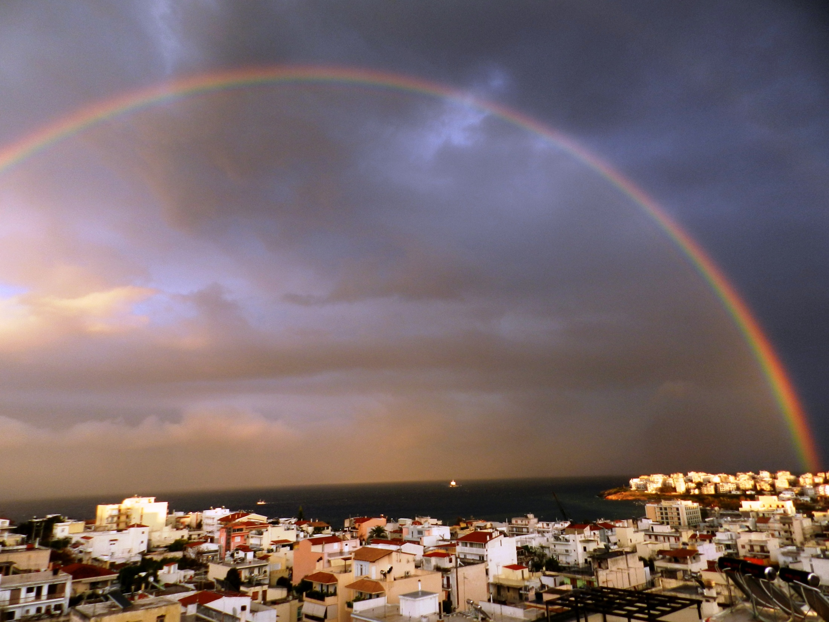
This is our little town ….

Slide 7
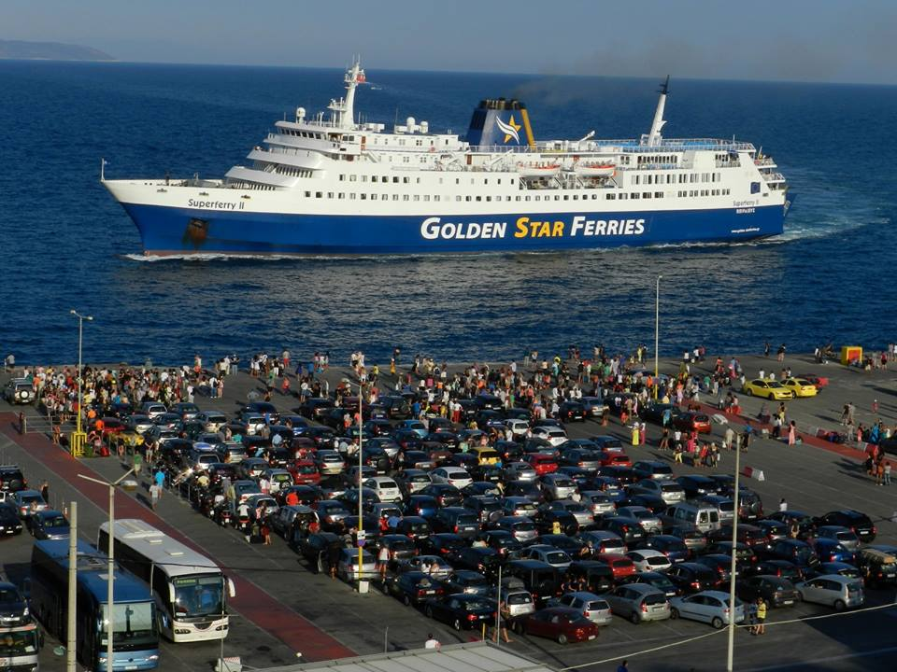
Port EconomicalActivities

Slide 8
Welcome in Rafina

Slide 9
23 of July 2018 The Day of the Big Fire

Slide 10
Megalo Rema Rafinas
Rafina Bay

Slide 11
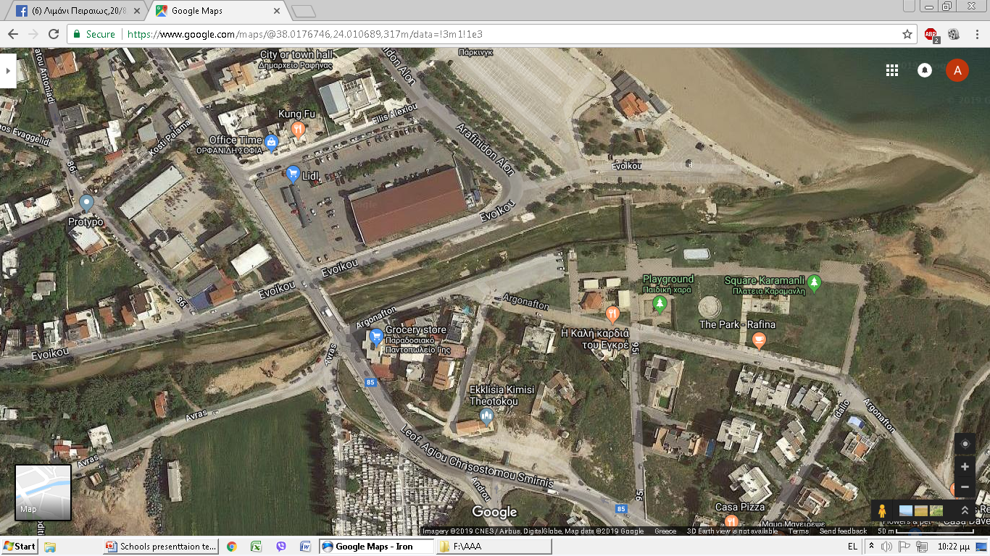
Estuary

Slide 12
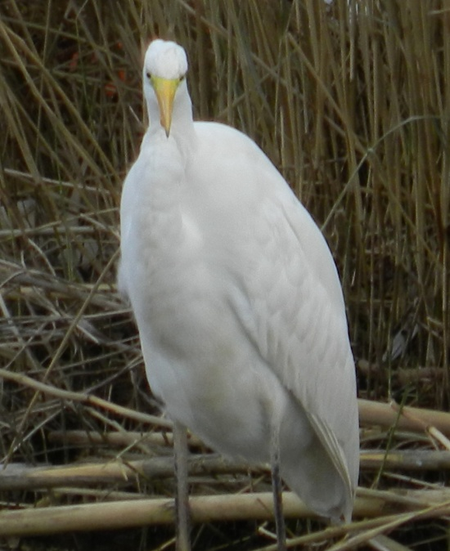
Wellcome to the Great Rafina Stream,
Megalo Rema Rafinas….

Slide 13
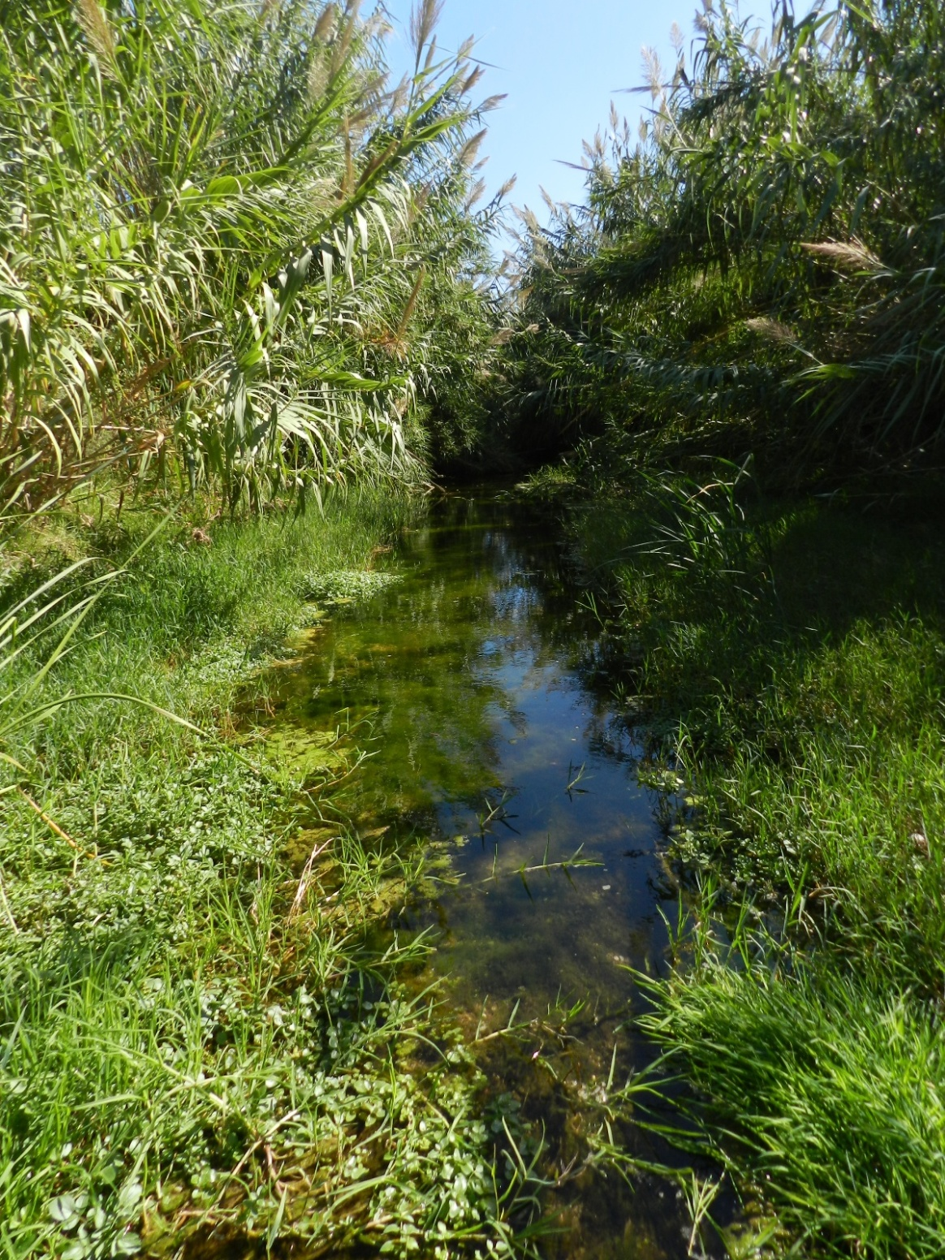
Megalo Rema Rafinas flows from Penteli Mountain for more than 20 Km

Slide 14
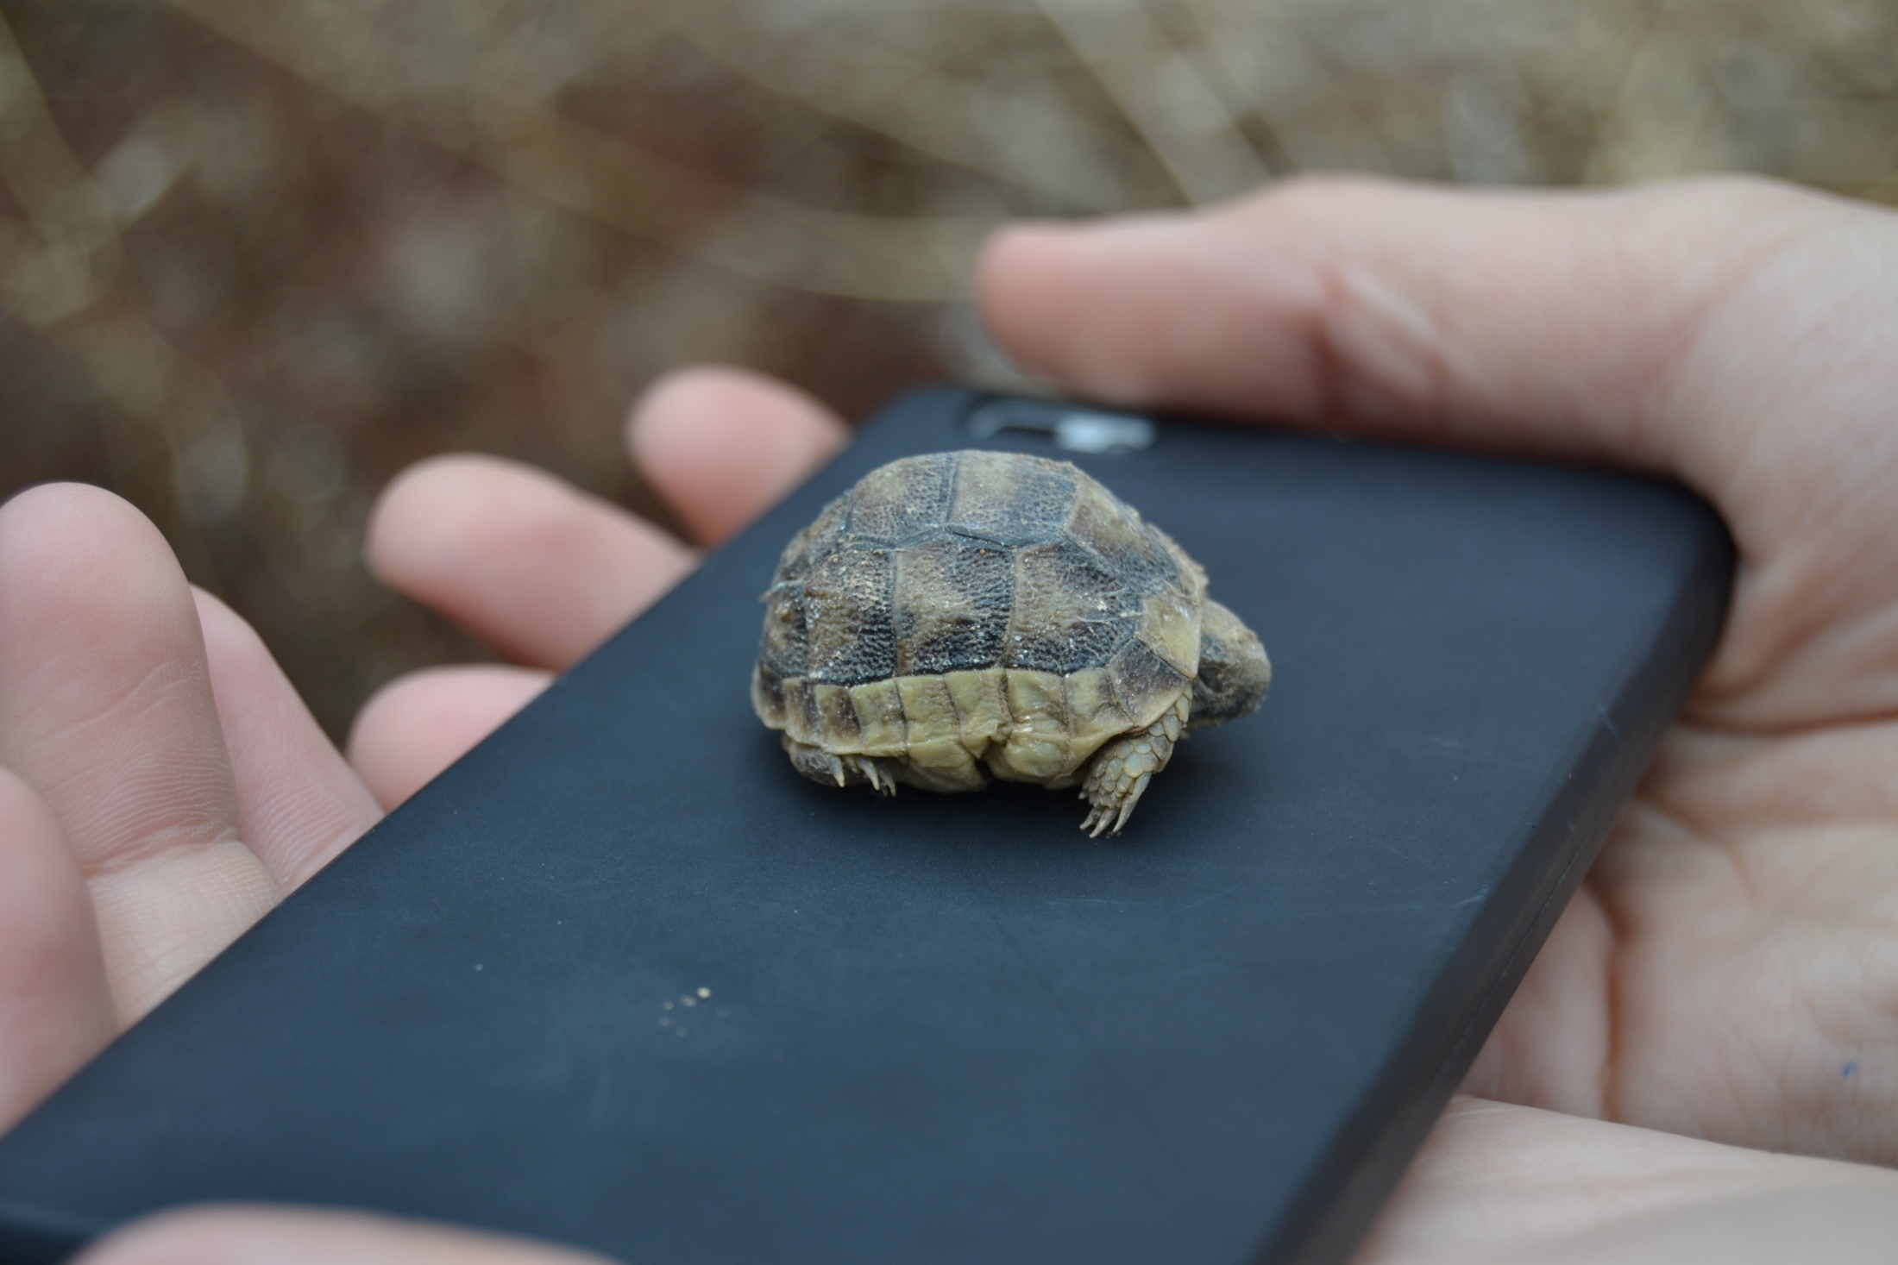

Slide 15
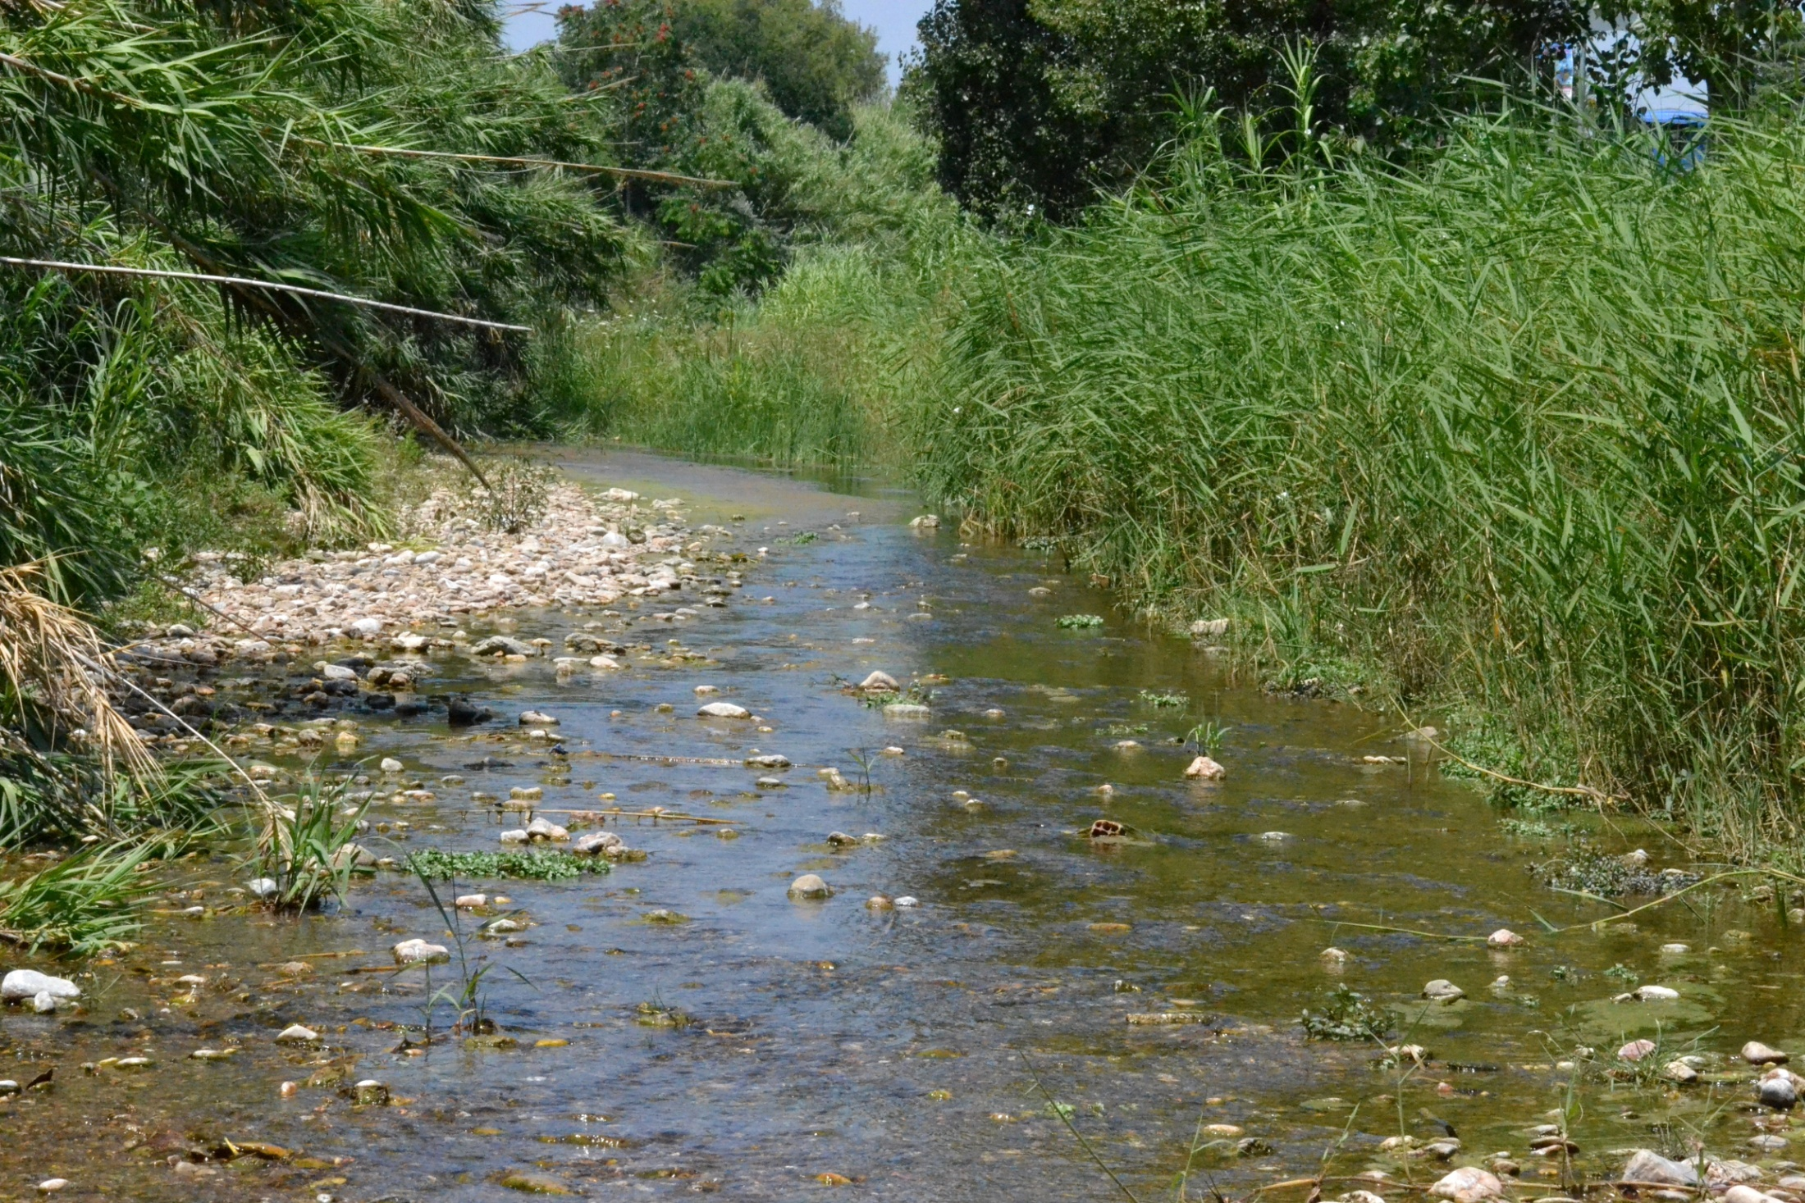
Megalo Rema Rafinas

Slide 16
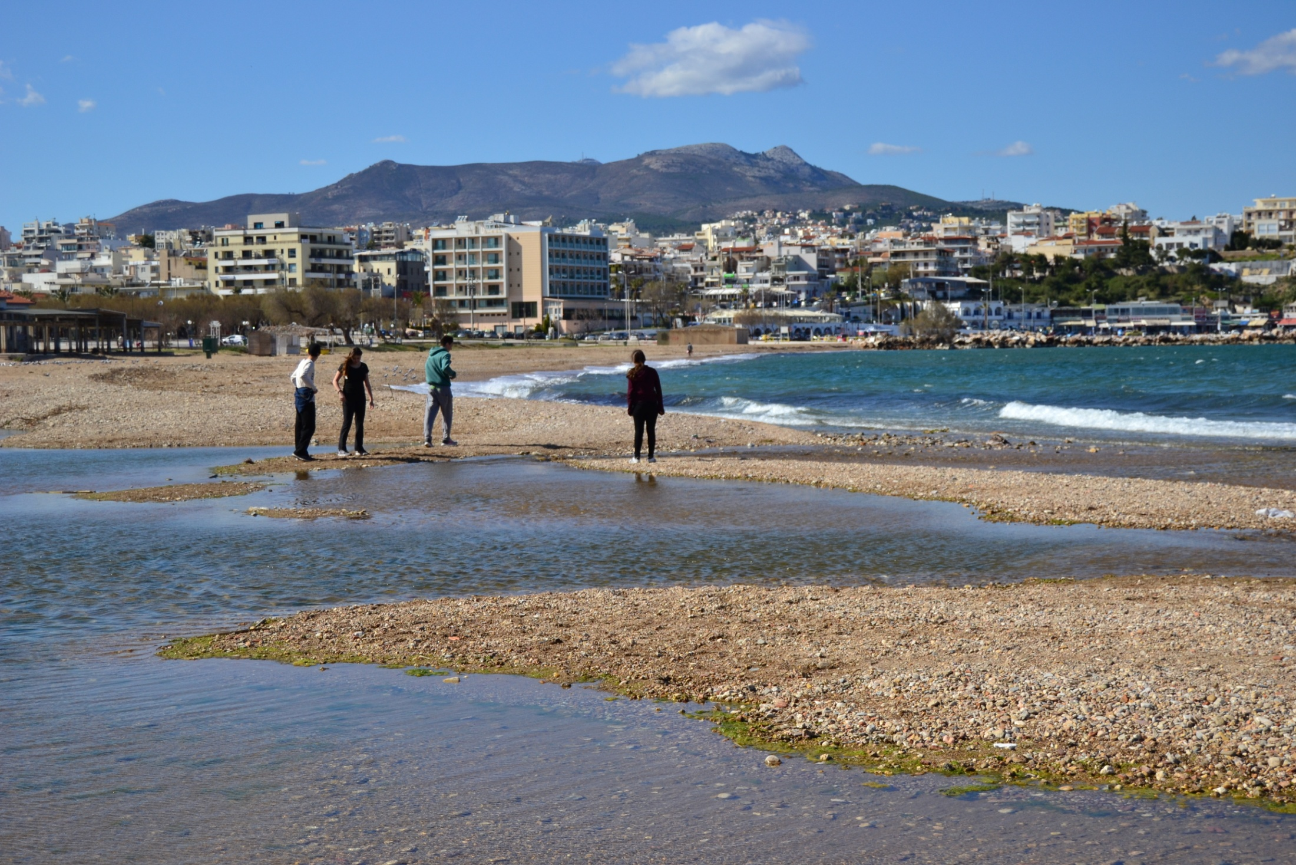
“Enviromental Education”

Slide 17
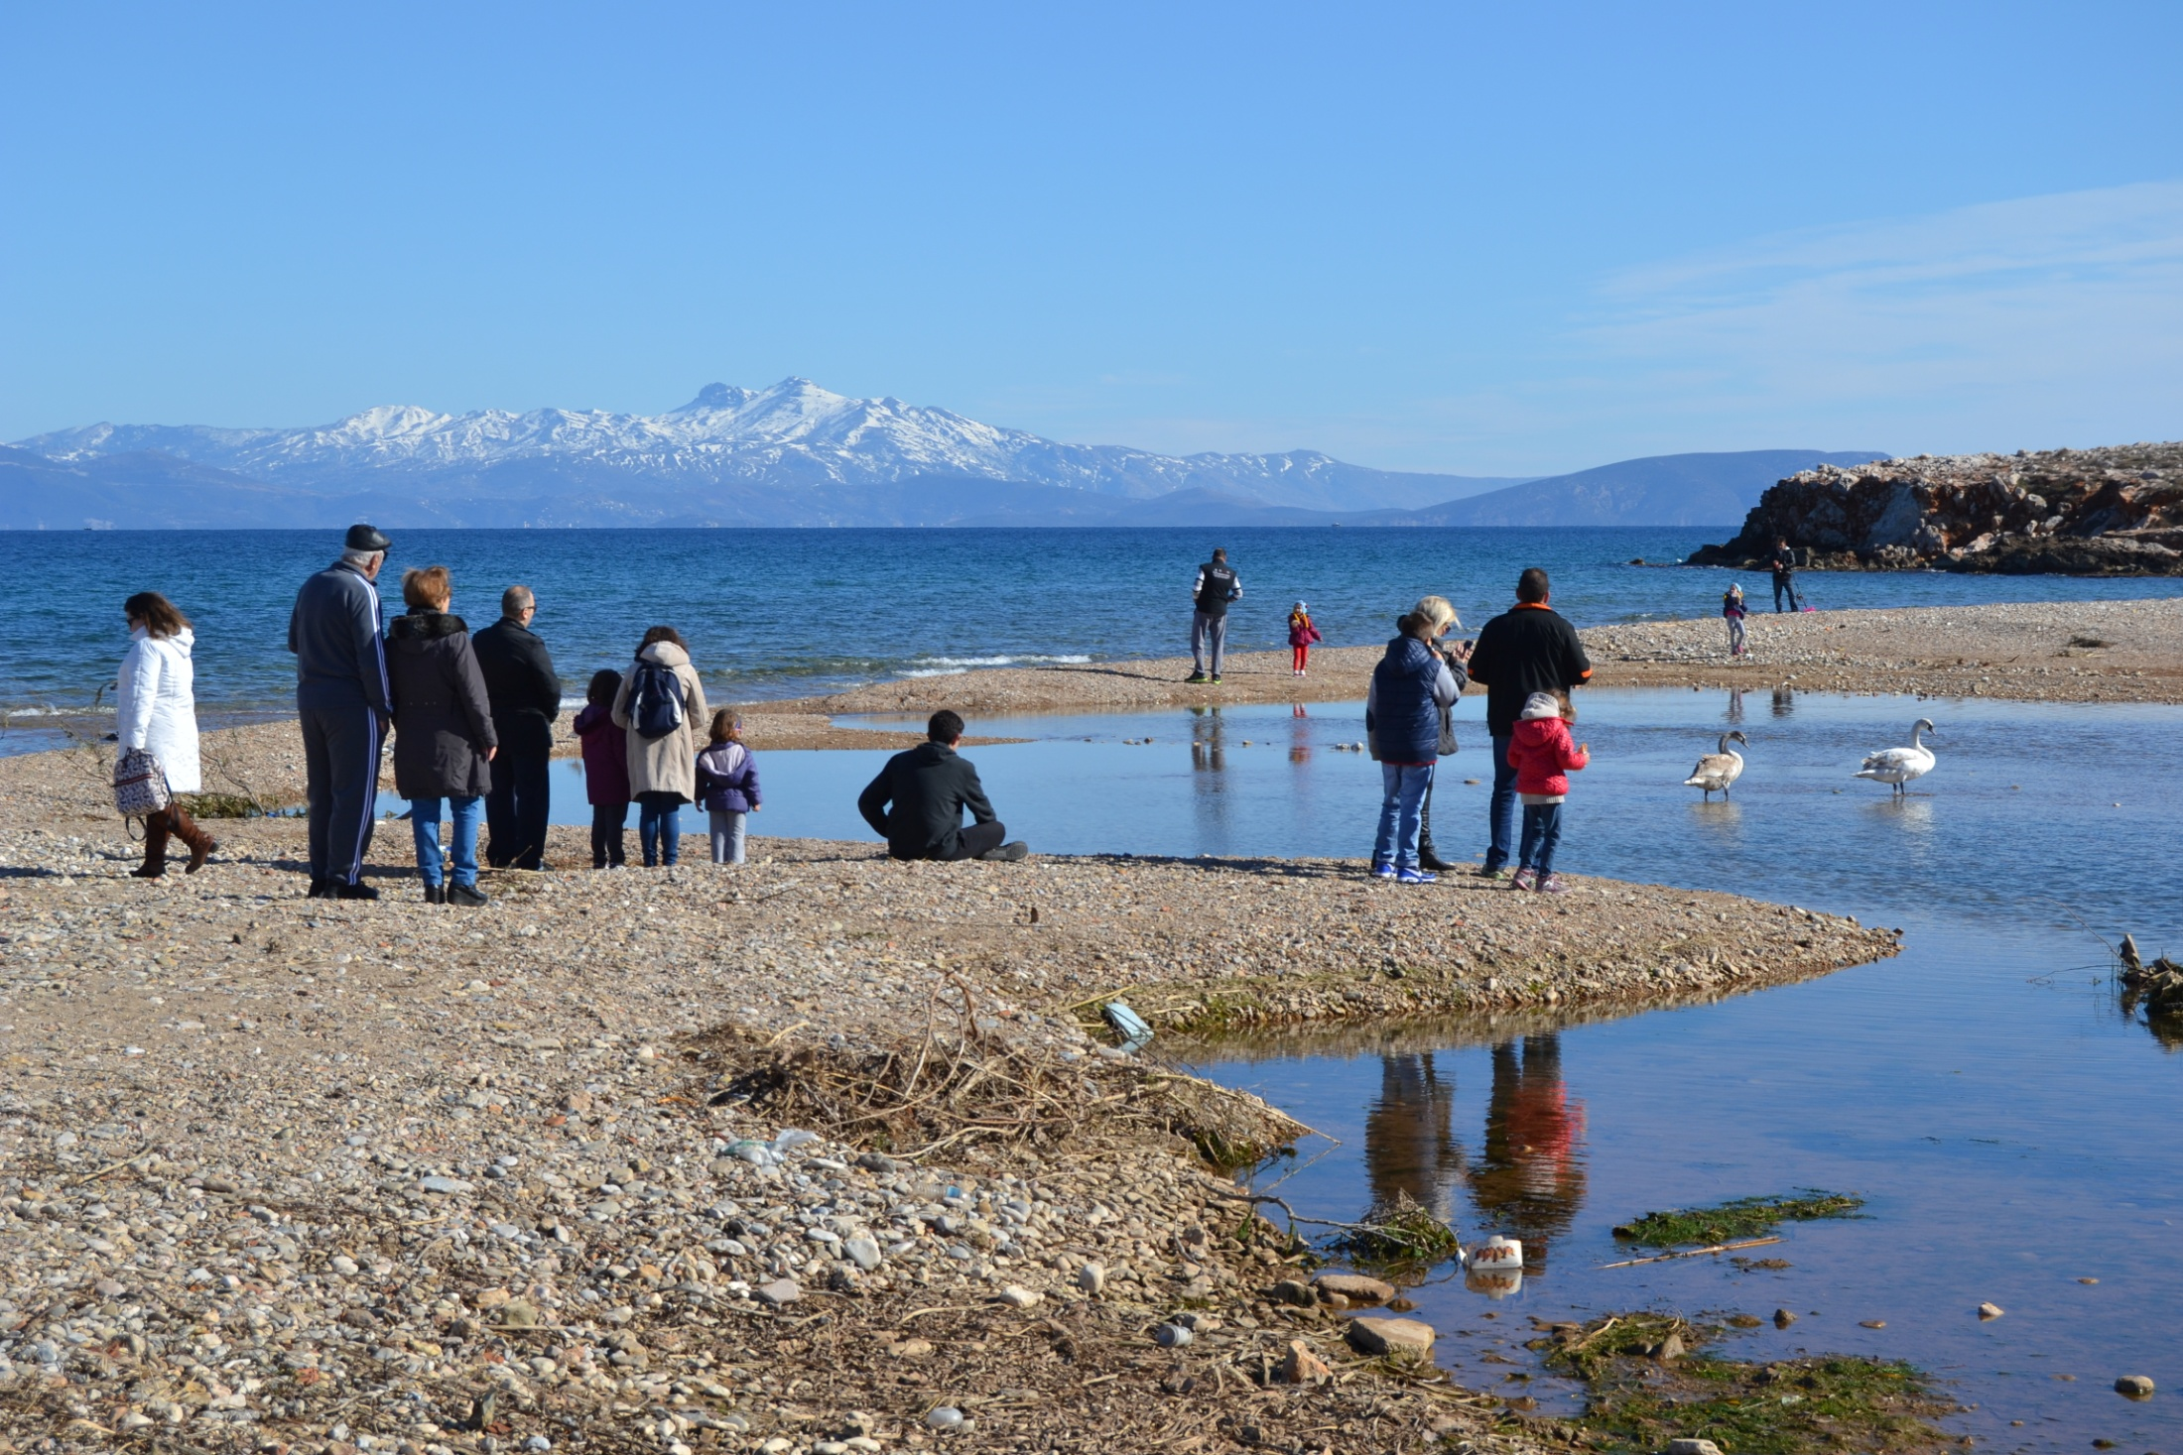

Slide 18
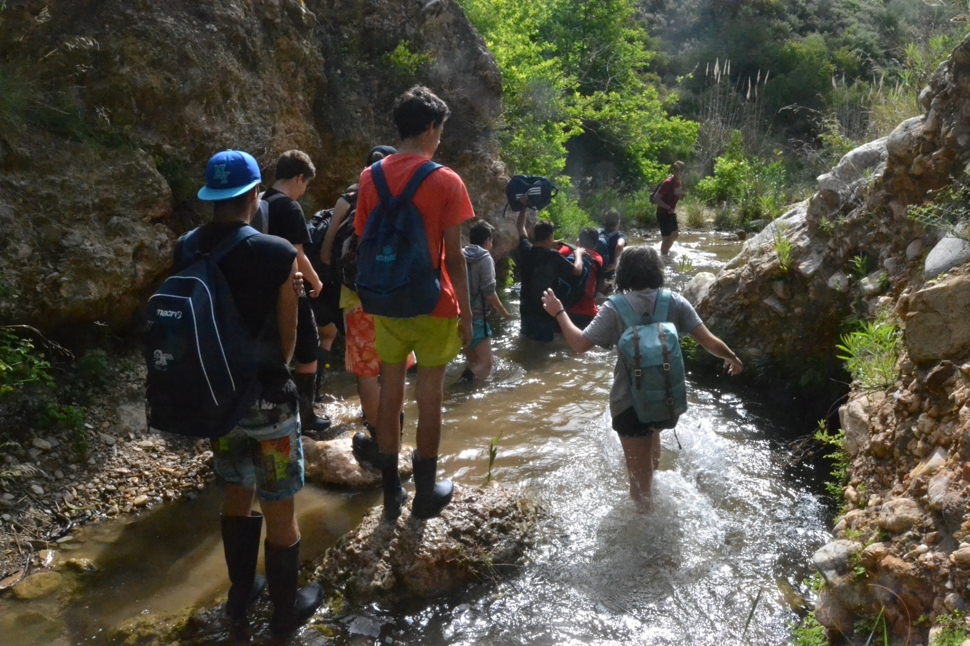

Slide 19
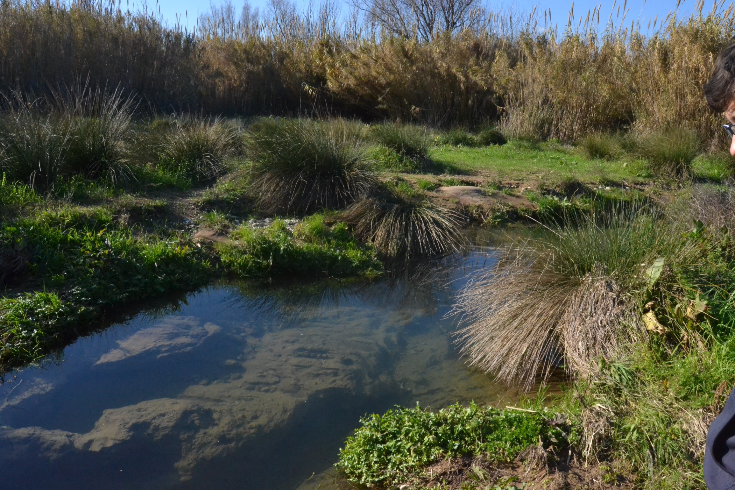

Slide 20
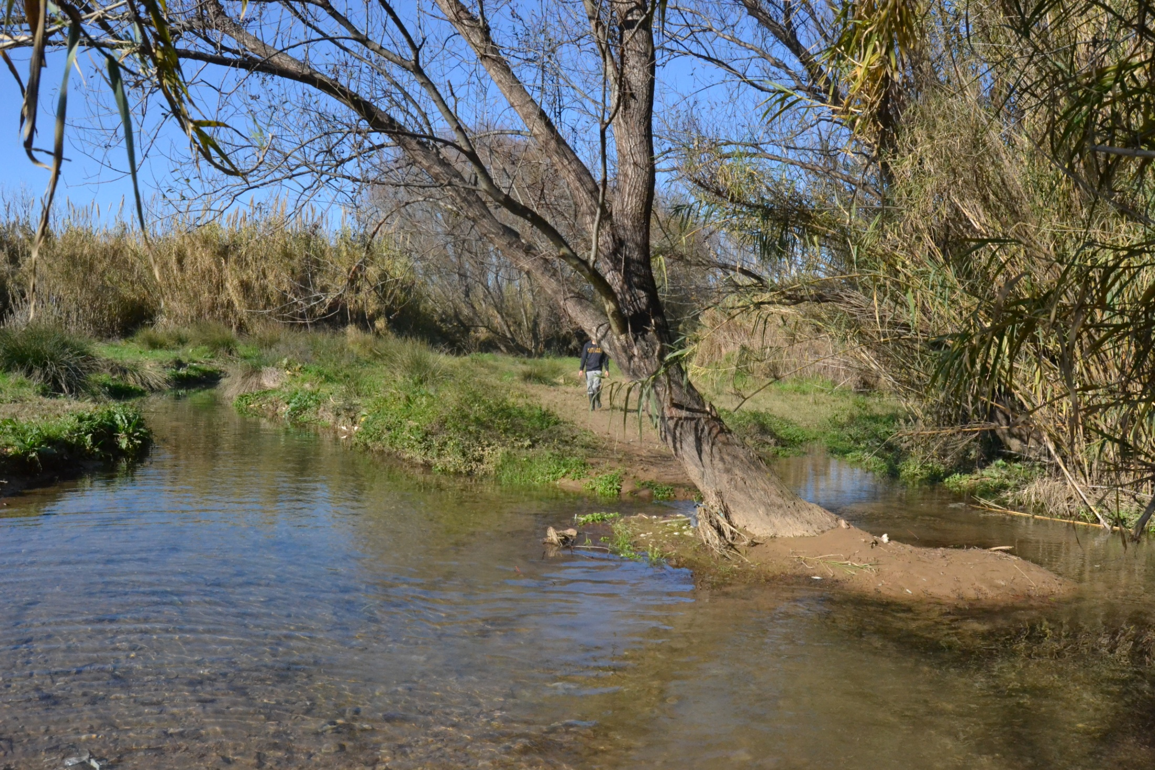

Slide 22
The beginning for our enviromental team

Slide 23
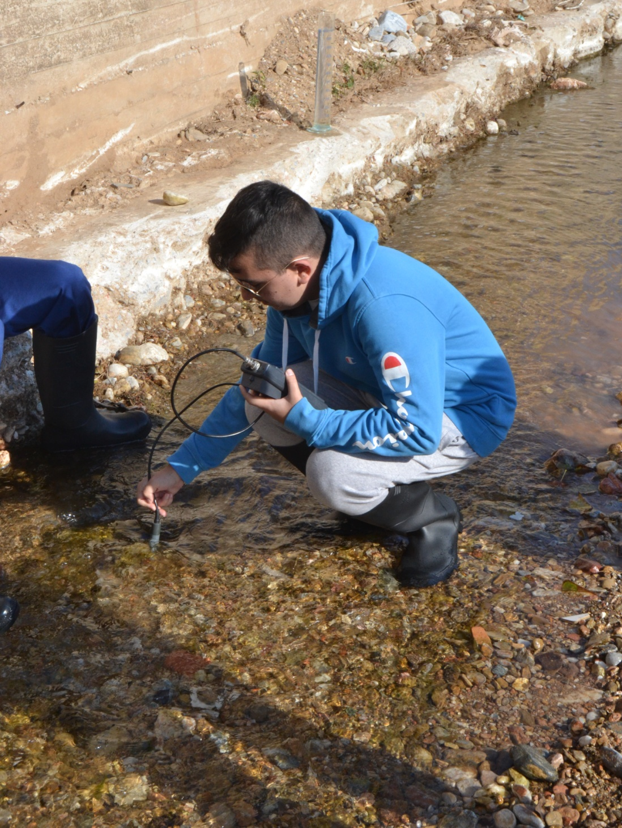

Slide 25
Field work

Slide 26
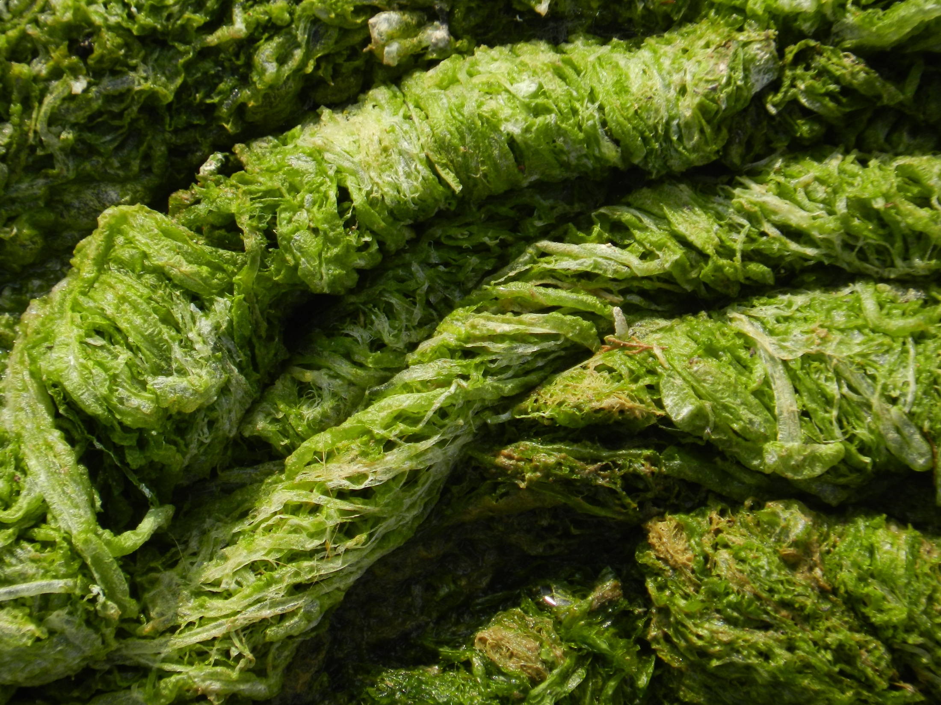
Eutrophication

Slide 27
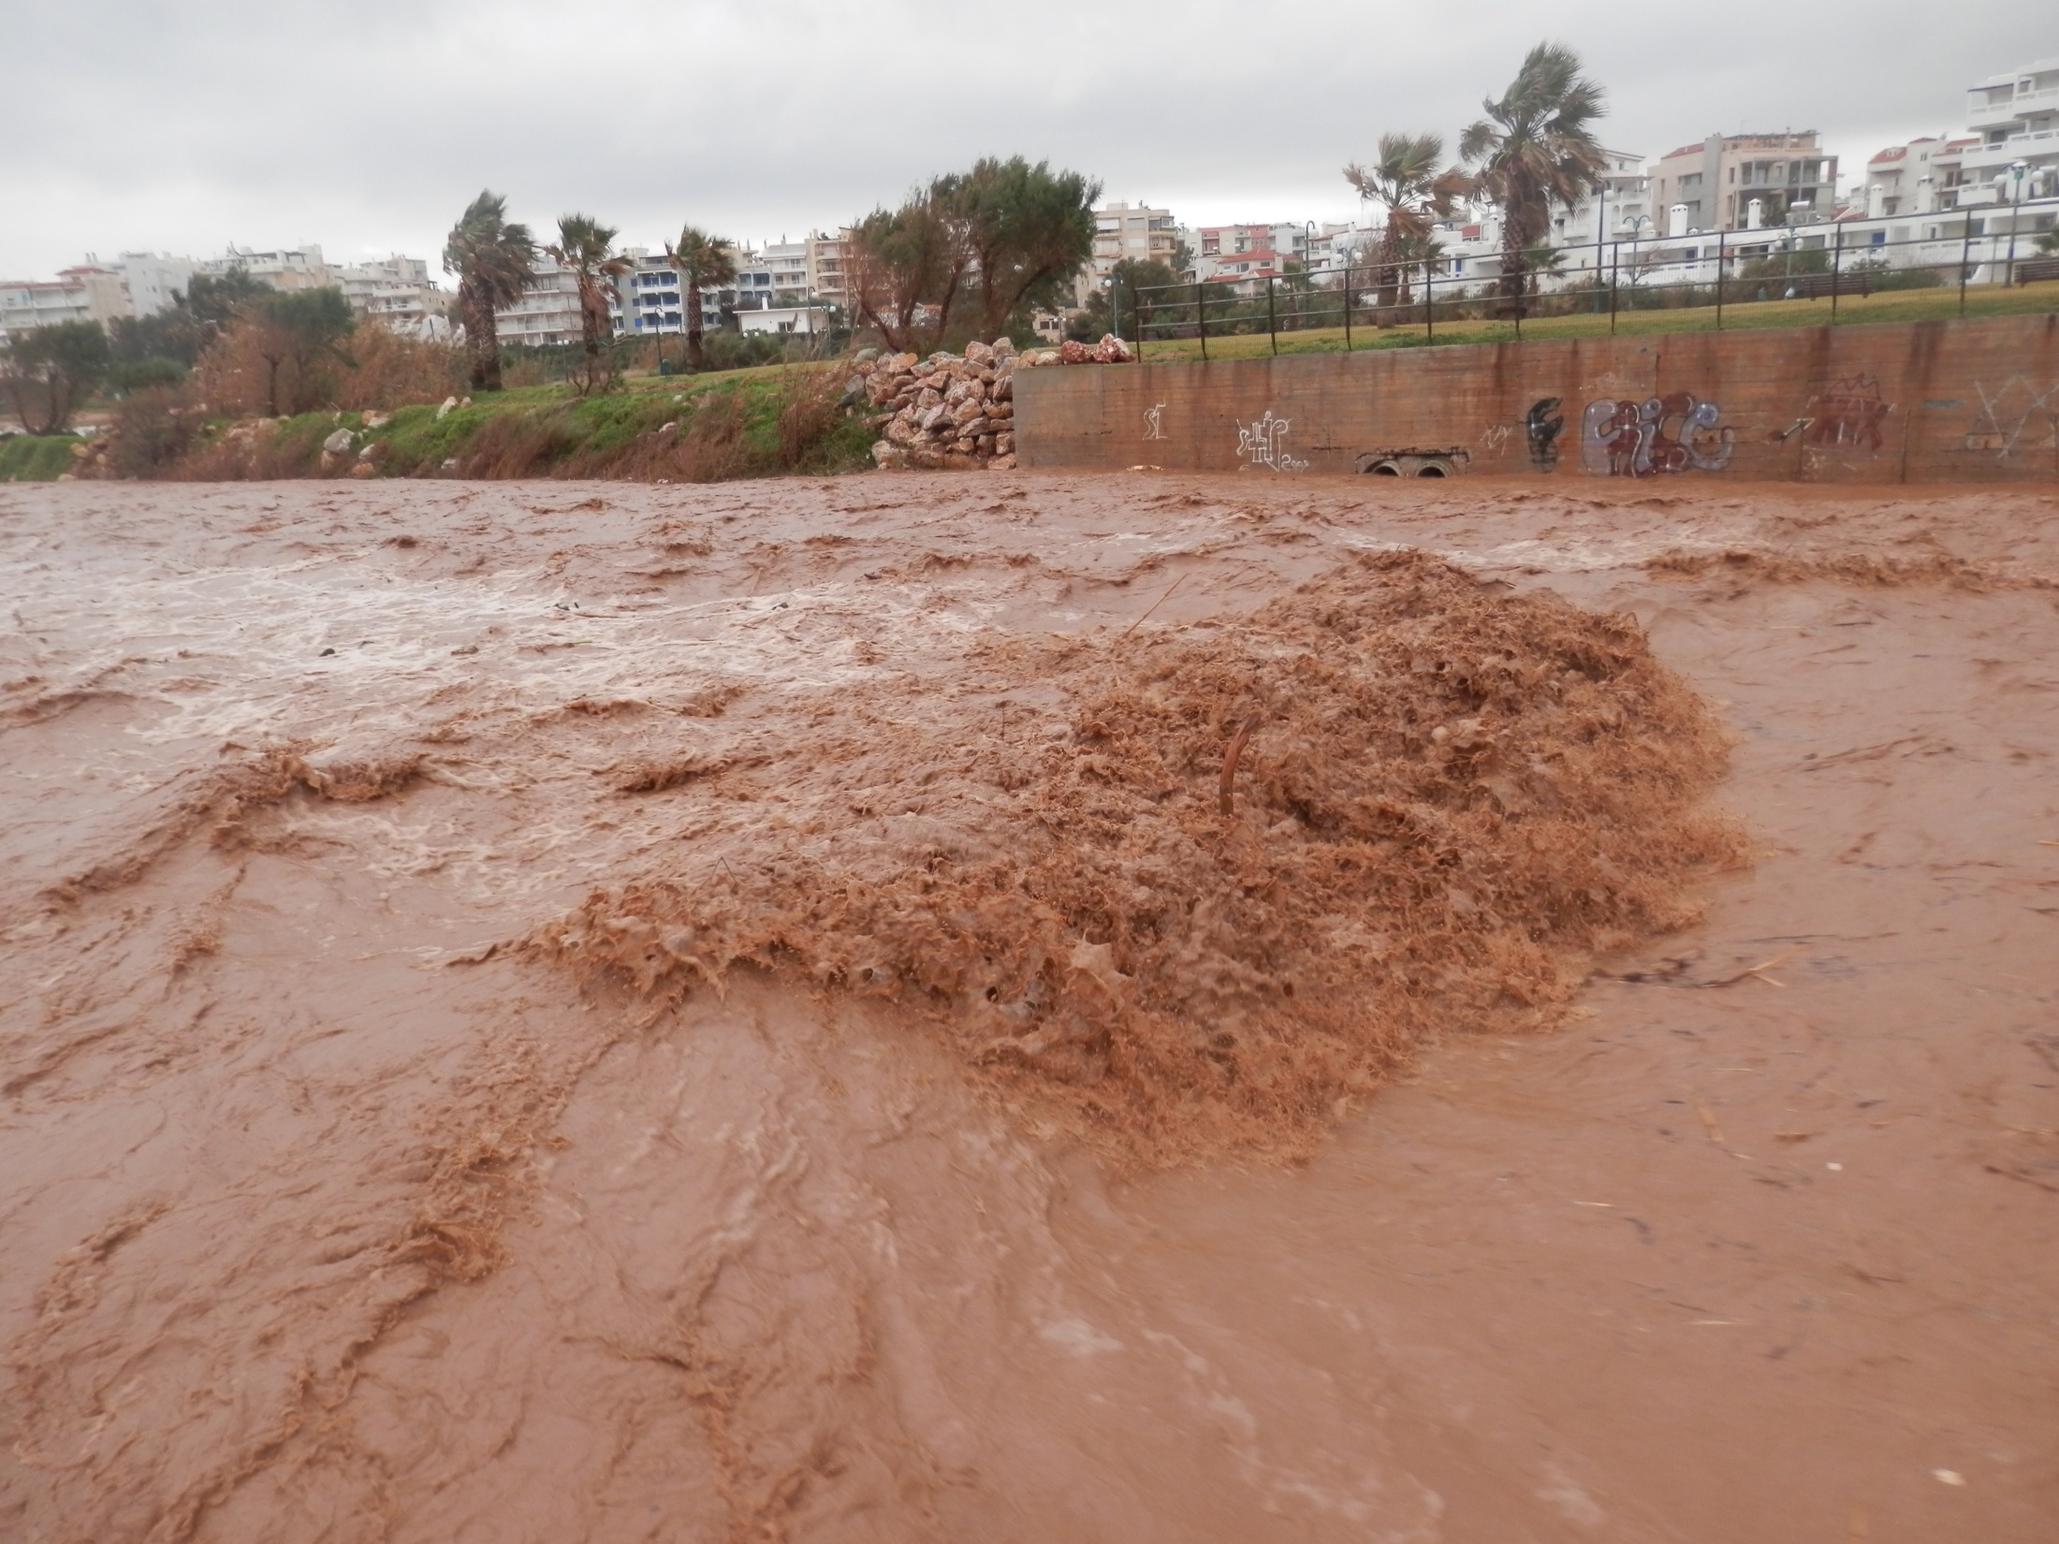

Slide 28
The river threatens to flood at any time, and that would mean the destruction of many properties. Some people would turn it into a road, in order to escape that danger once and for all.

Slide 29
That the river ecosystem will be destroyed permanently if it turns into a road
But we know very well:

Slide 30
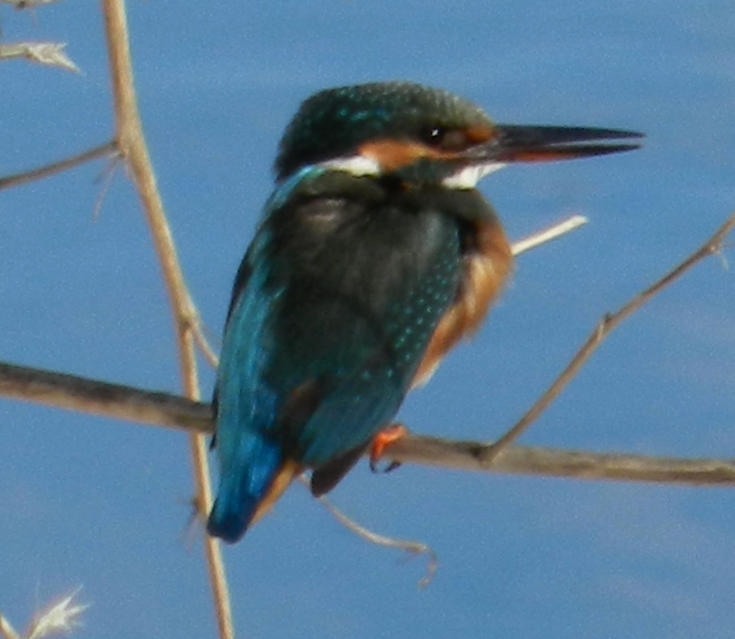
Although the river has been significantly spoiled due to human interference and is endangered as an ecosystem.

Slide 31
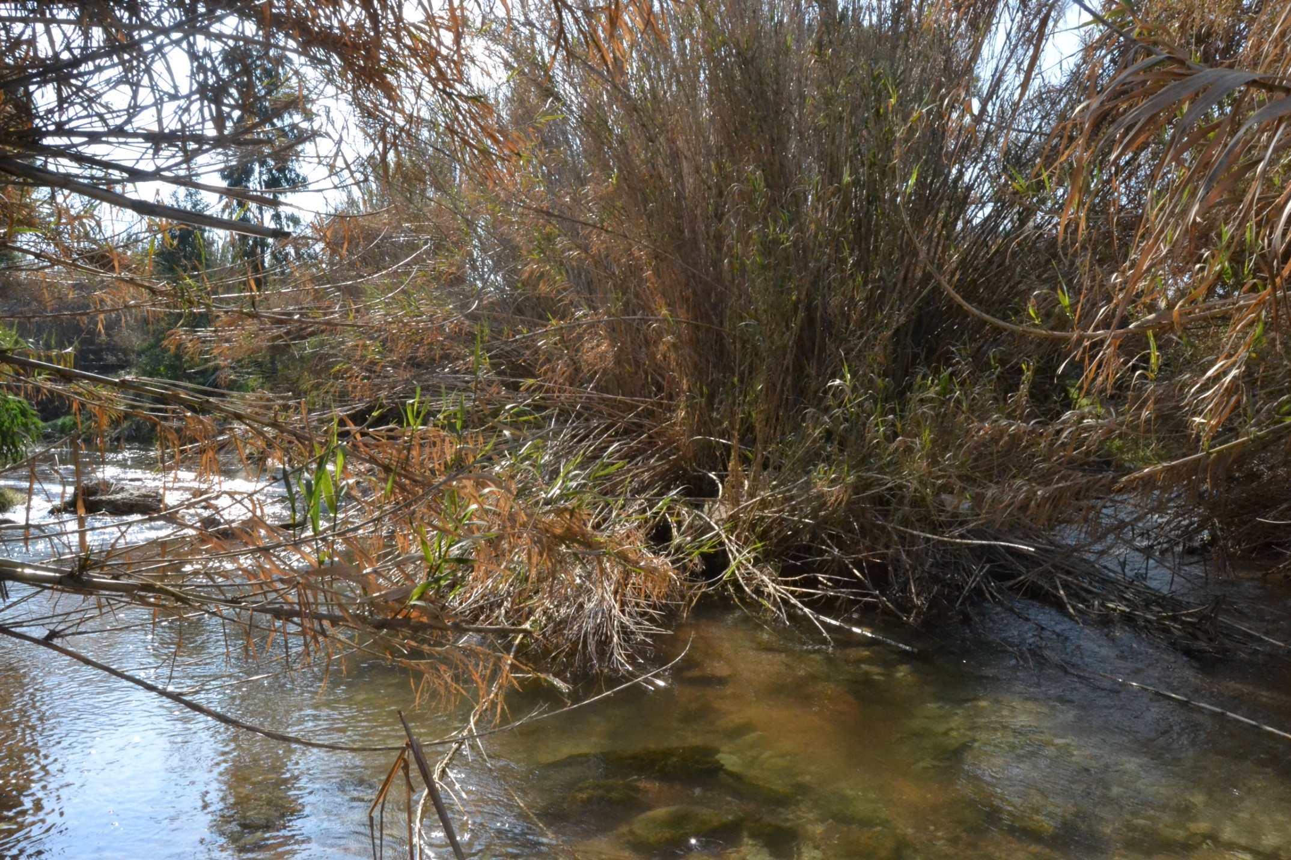

Slide 32
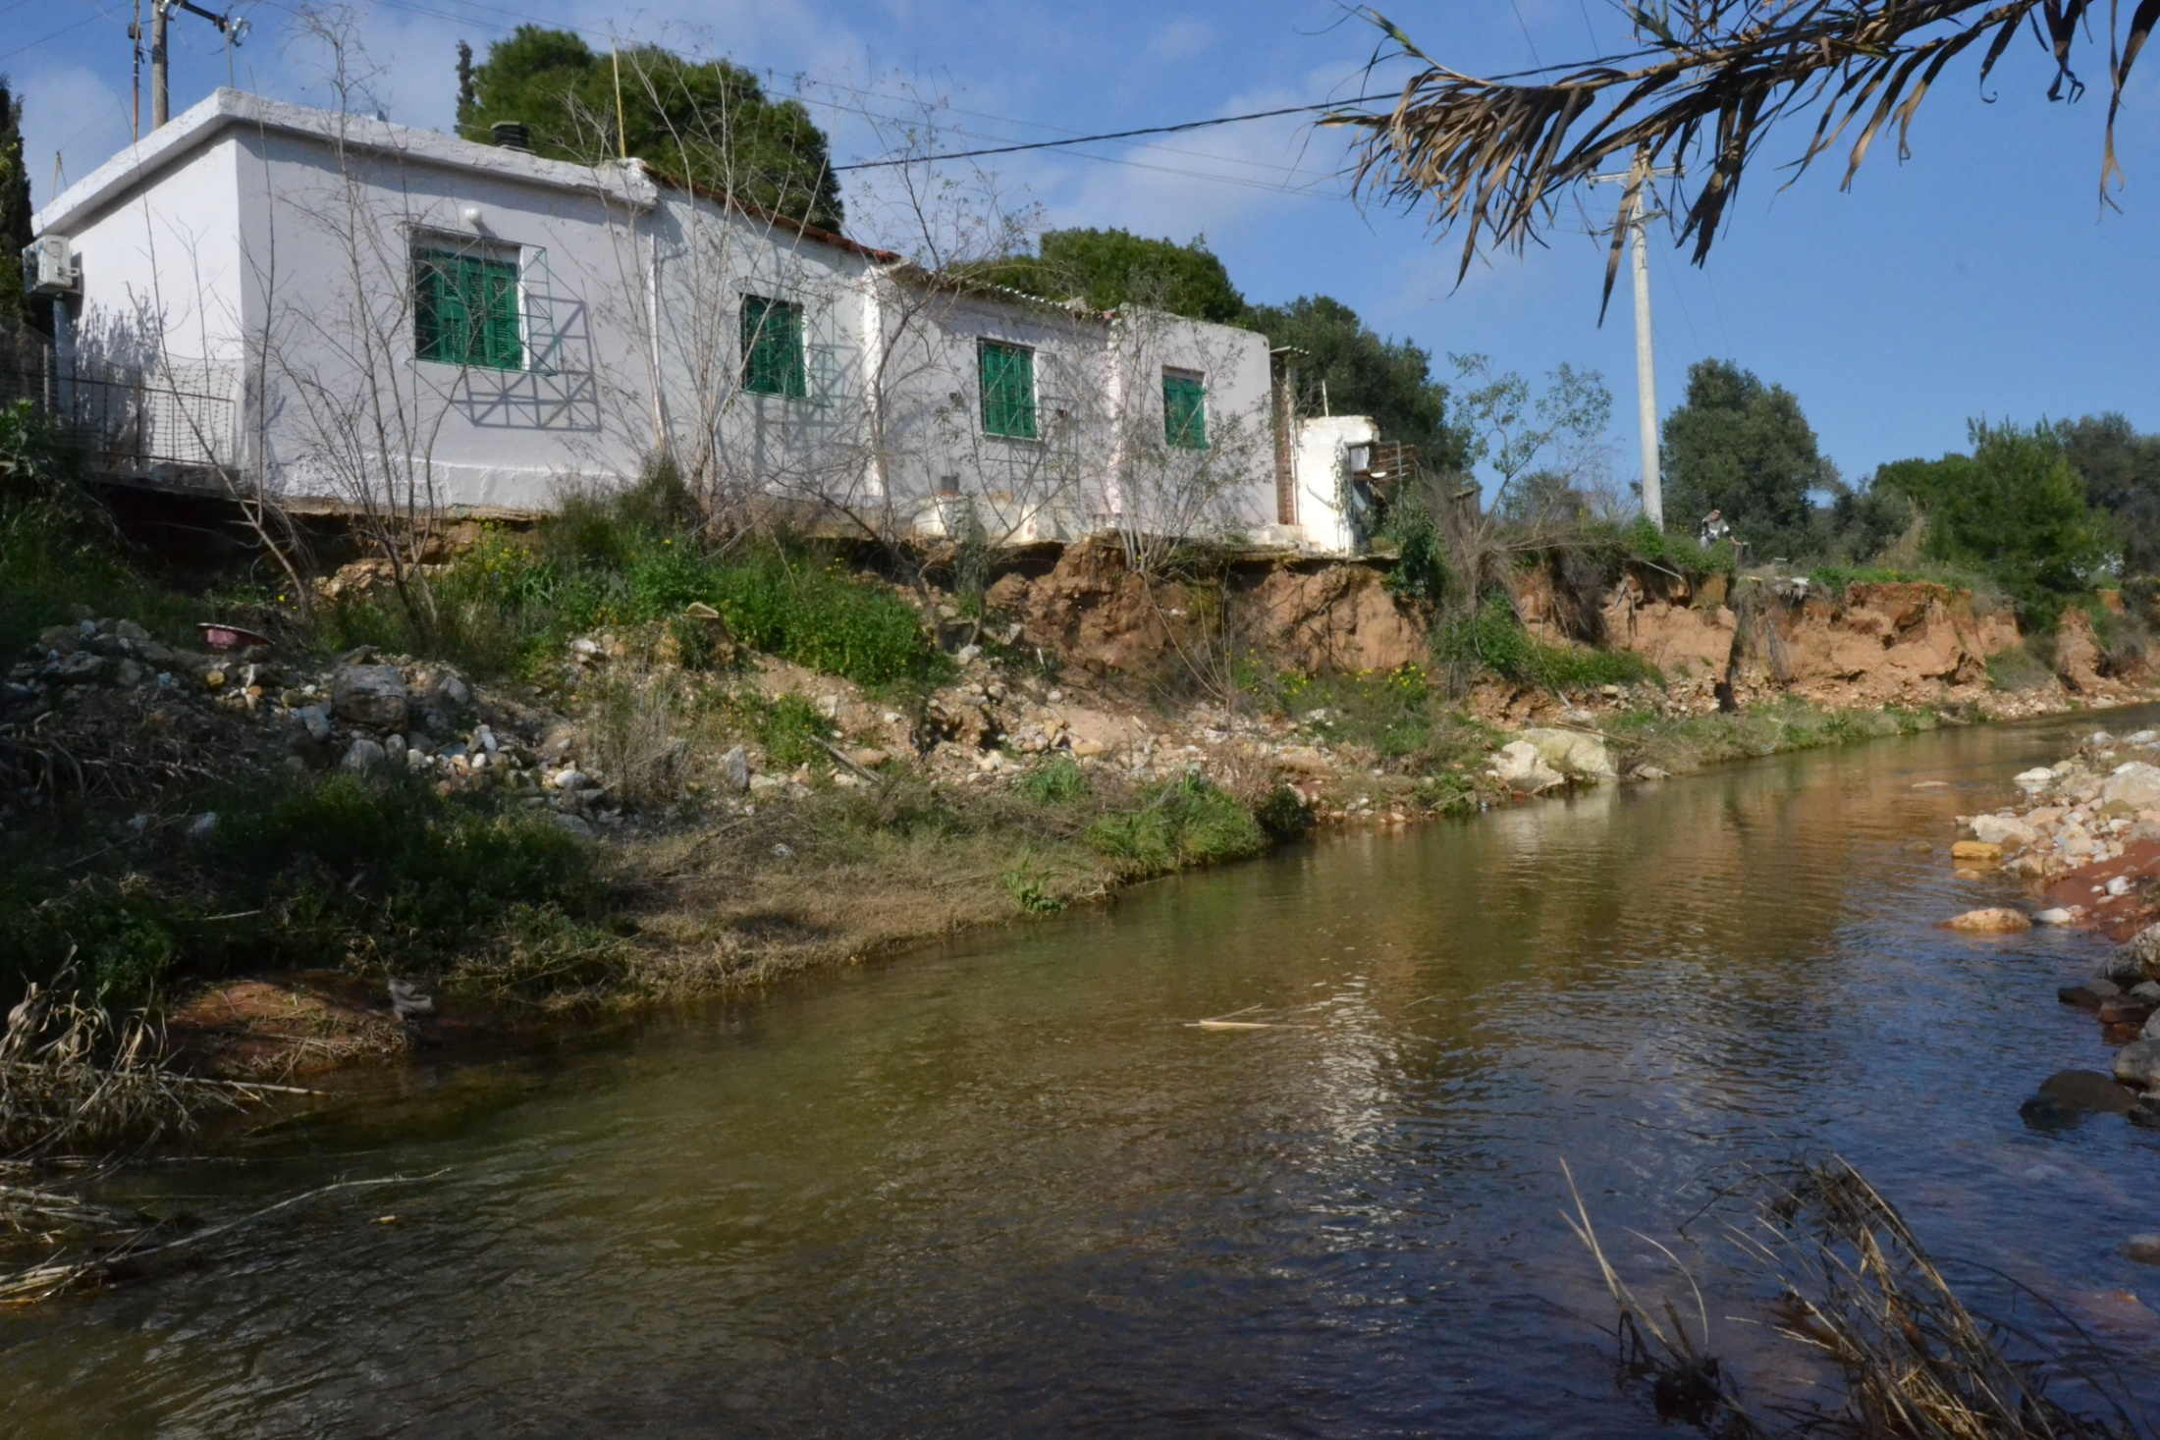

Slide 33
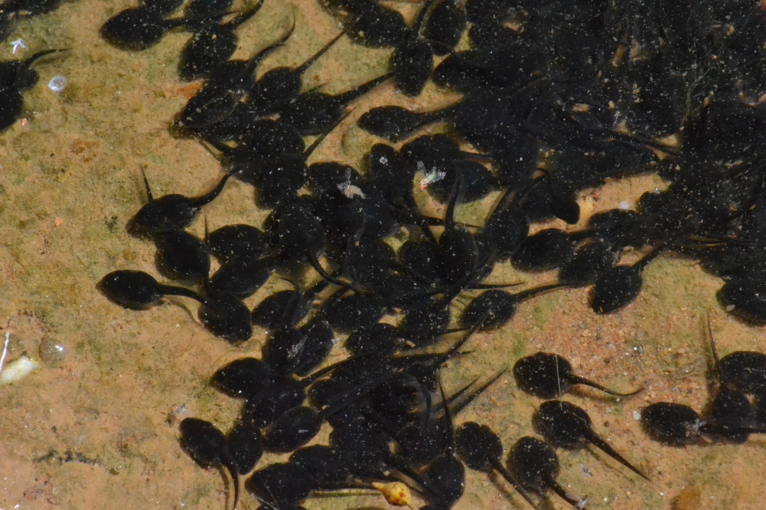

Slide 34
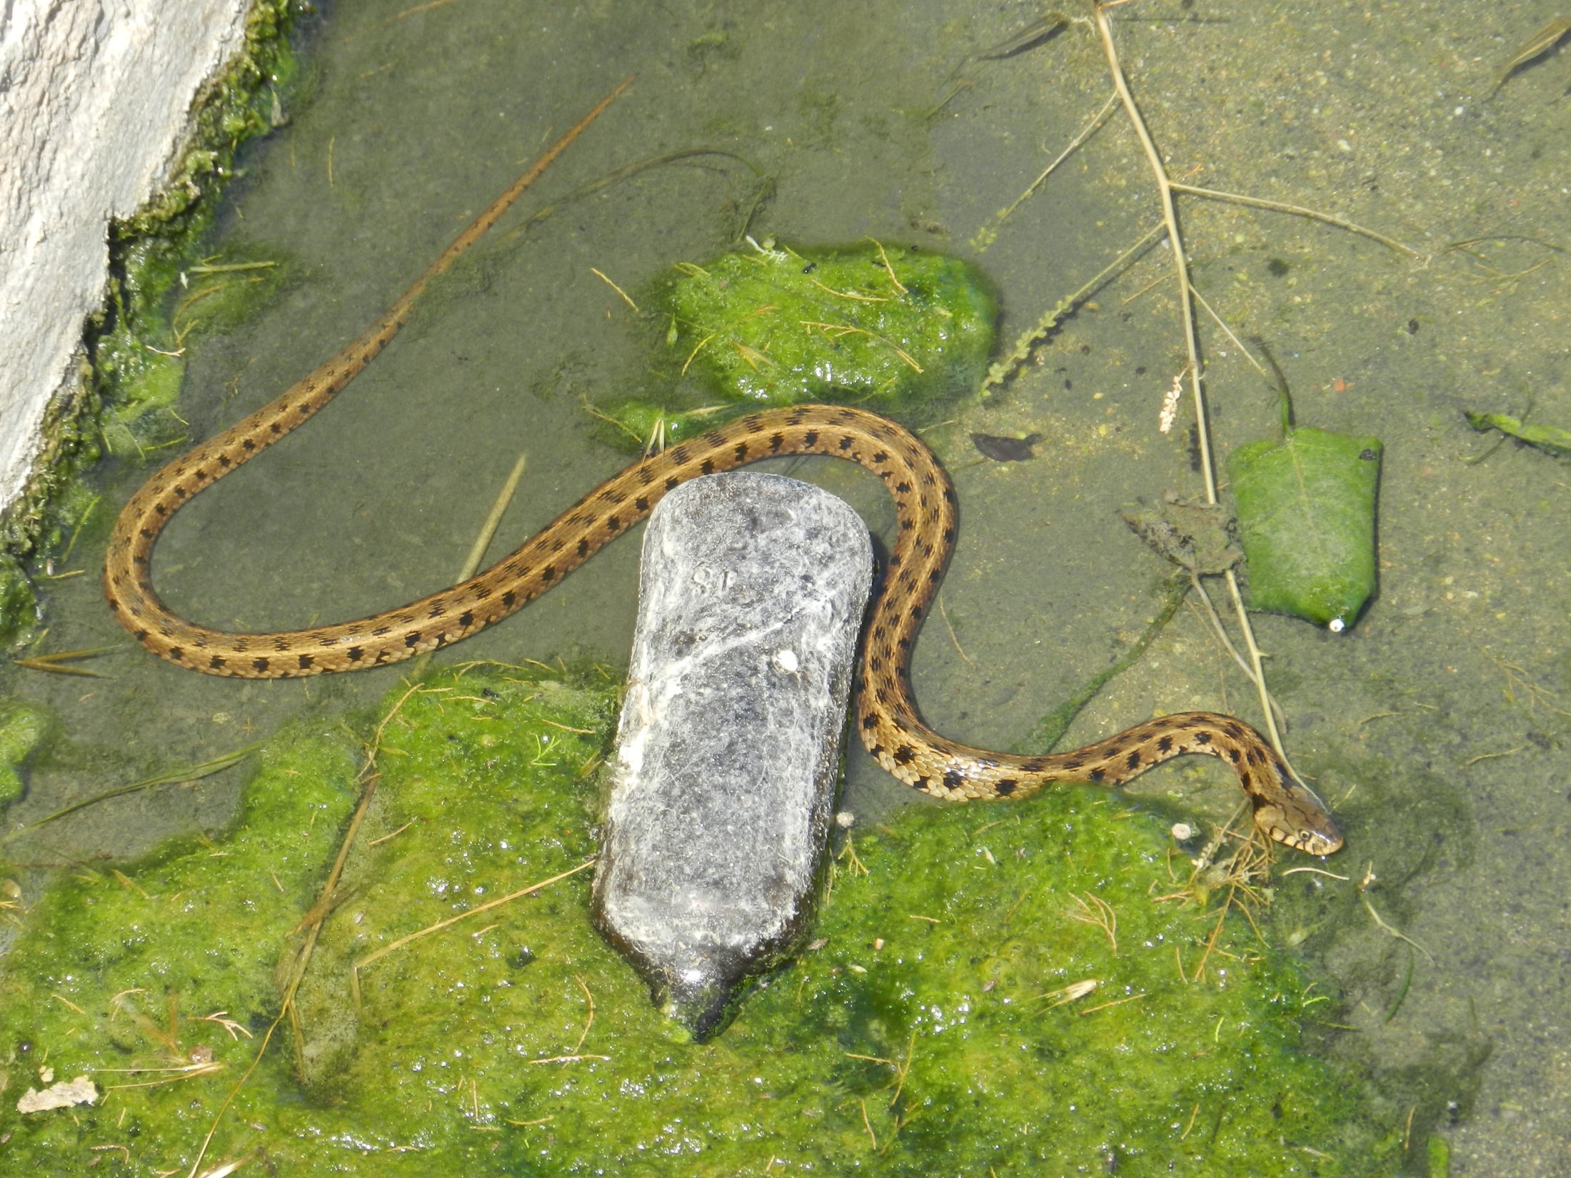

Slide 35
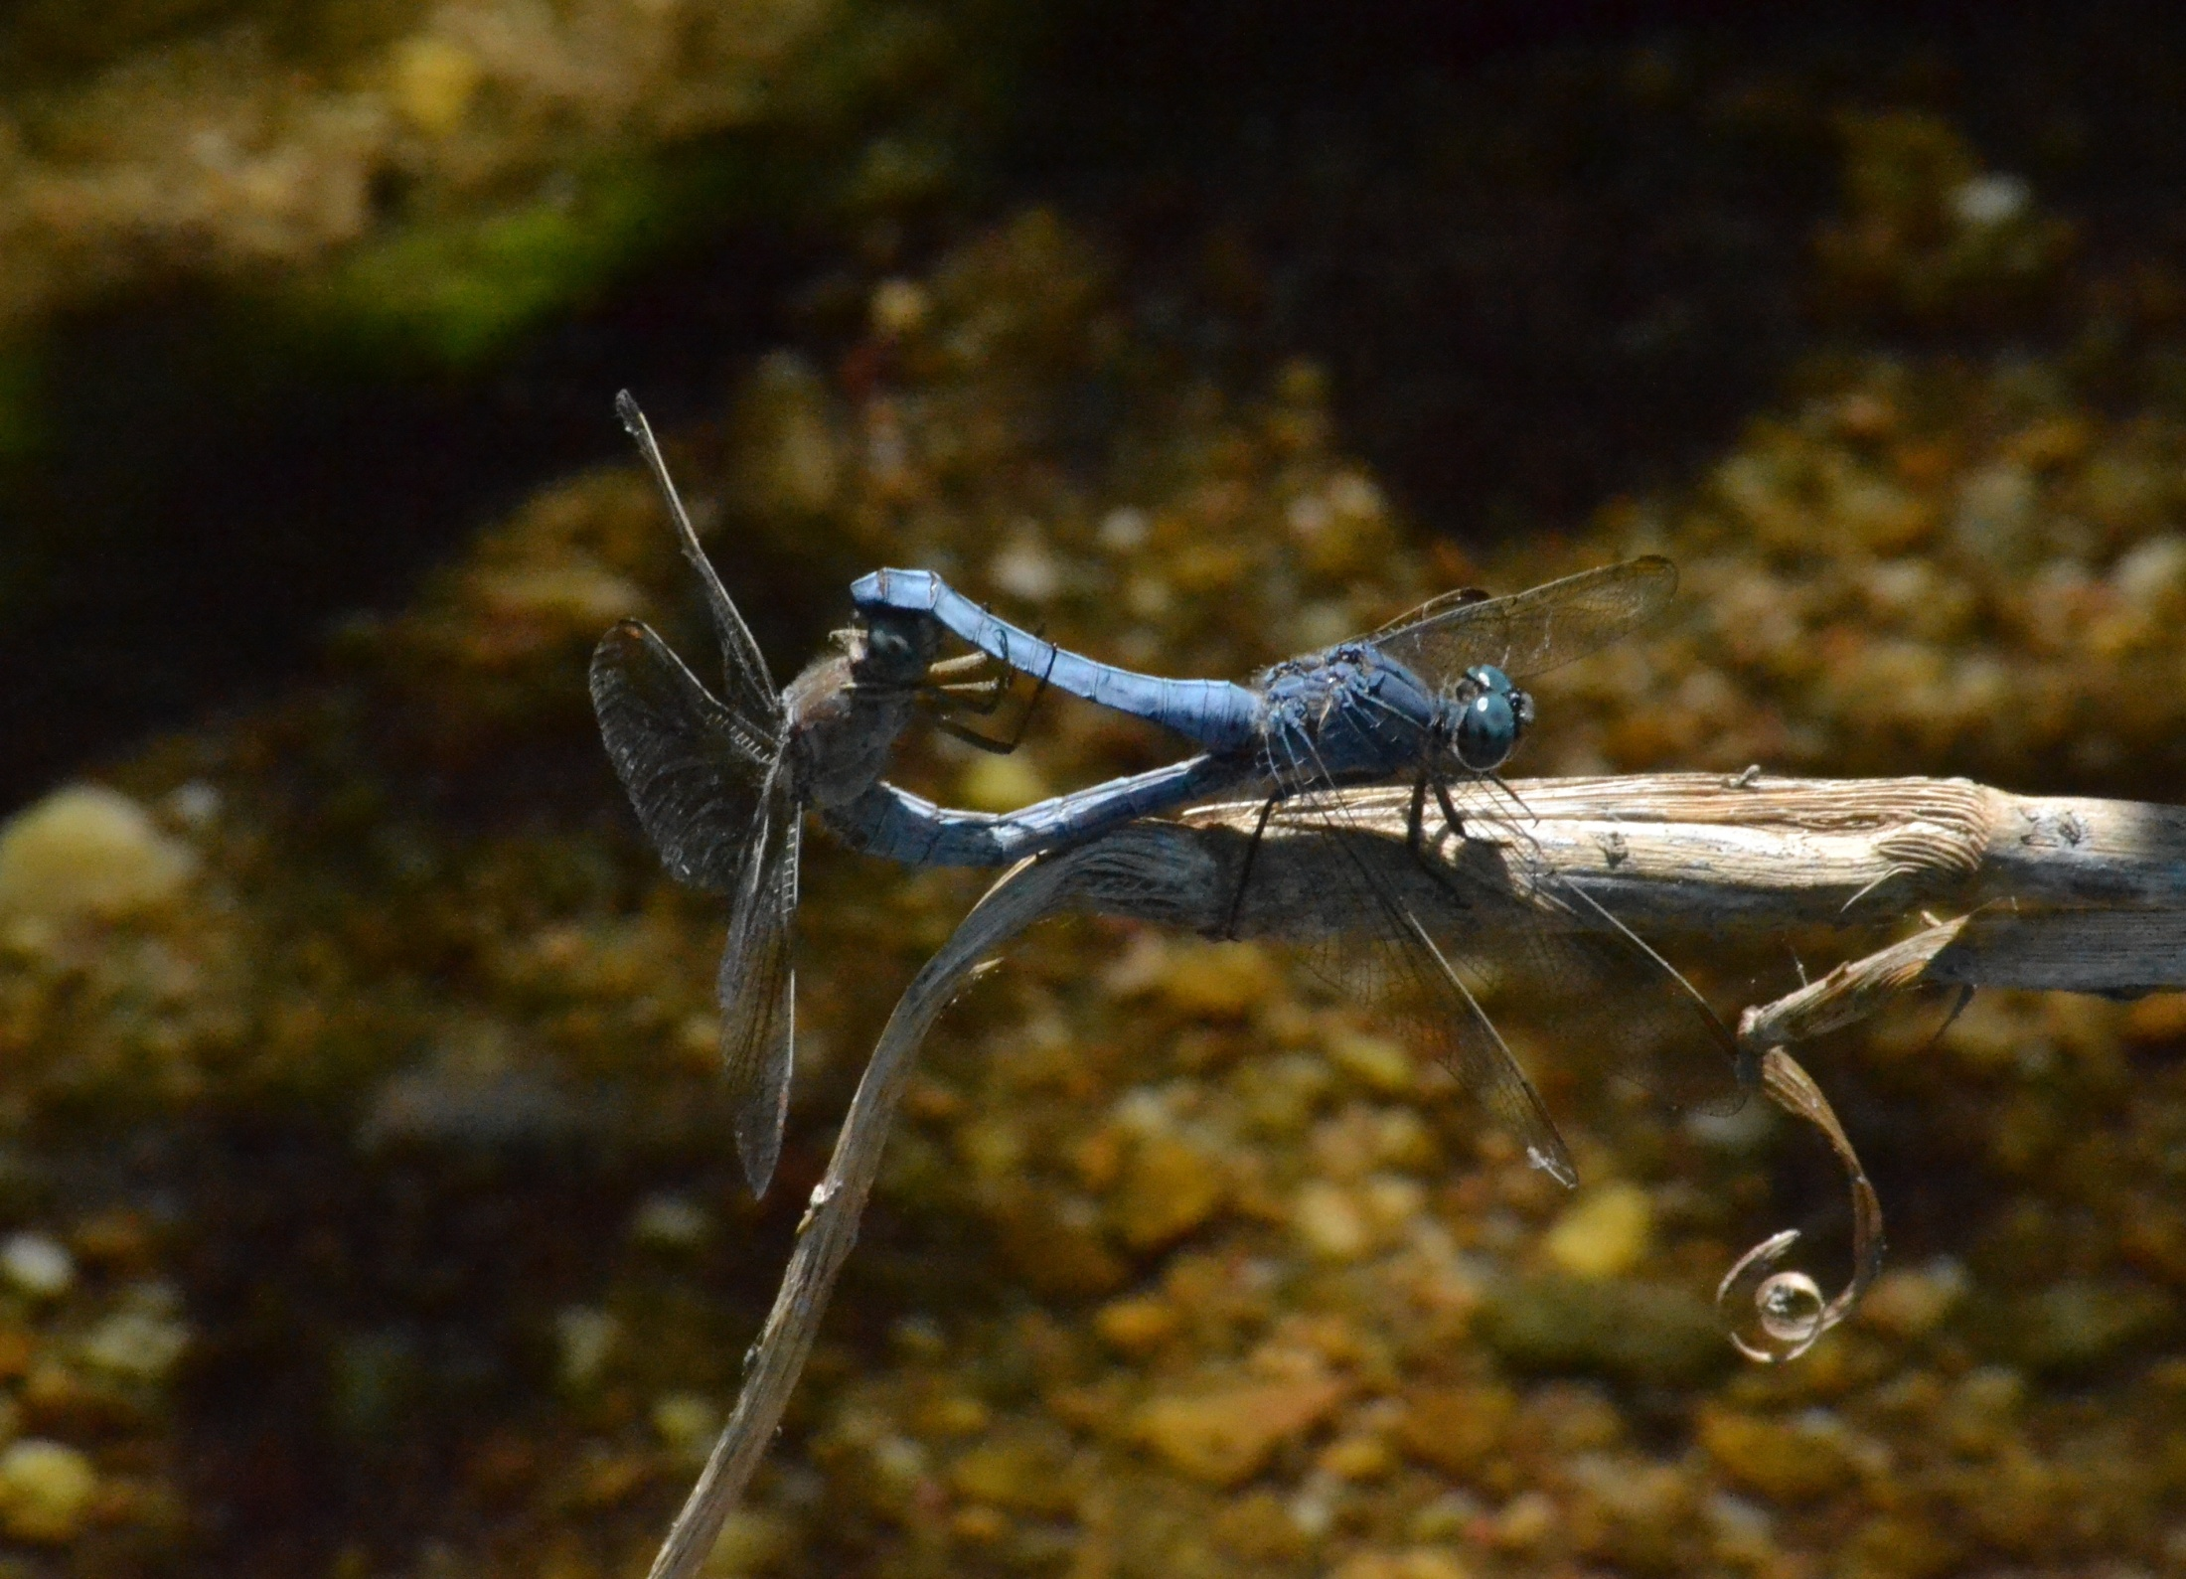

Slide 36
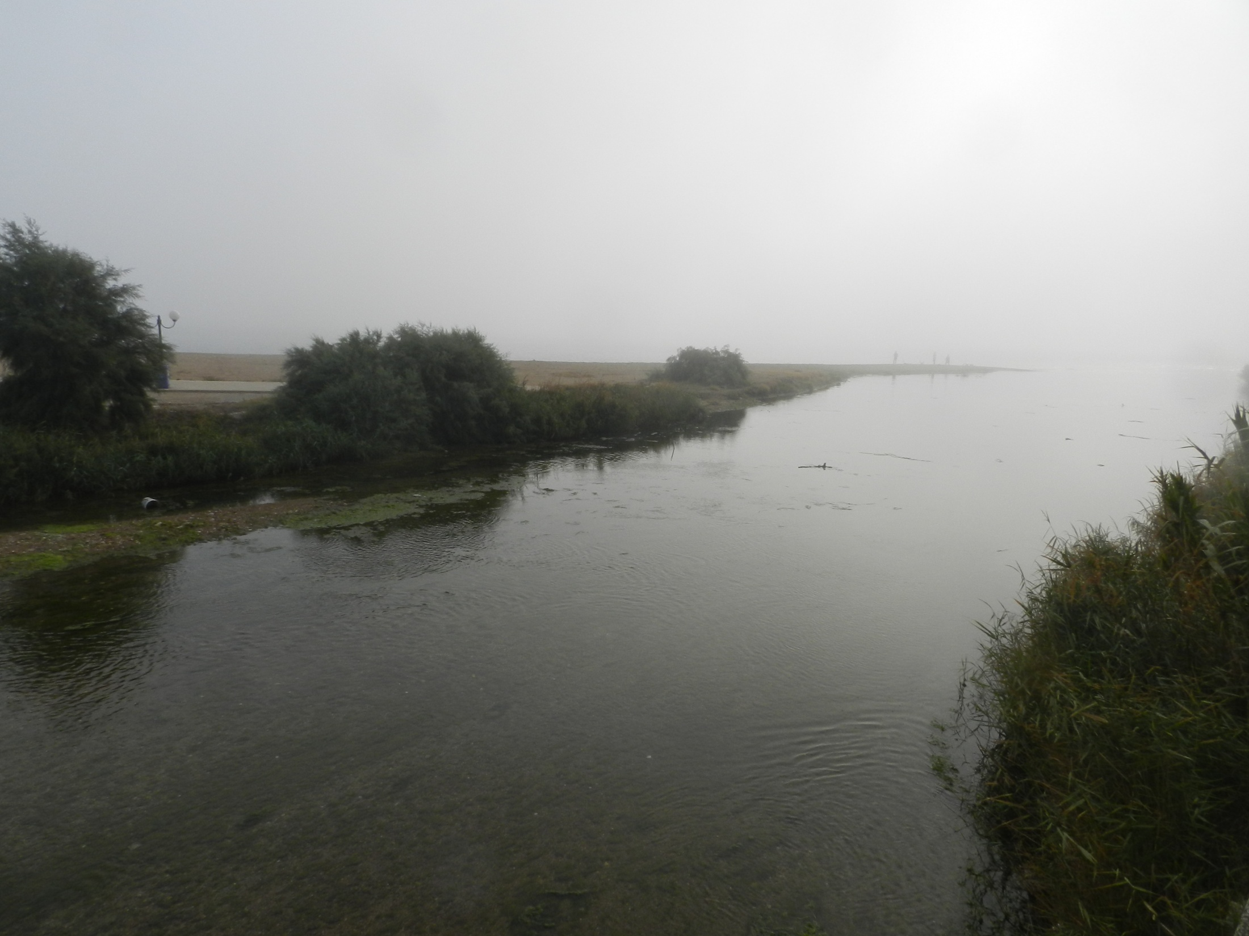
The canalization of the River would be an other enviromental disaster for Rafina

Slide 37
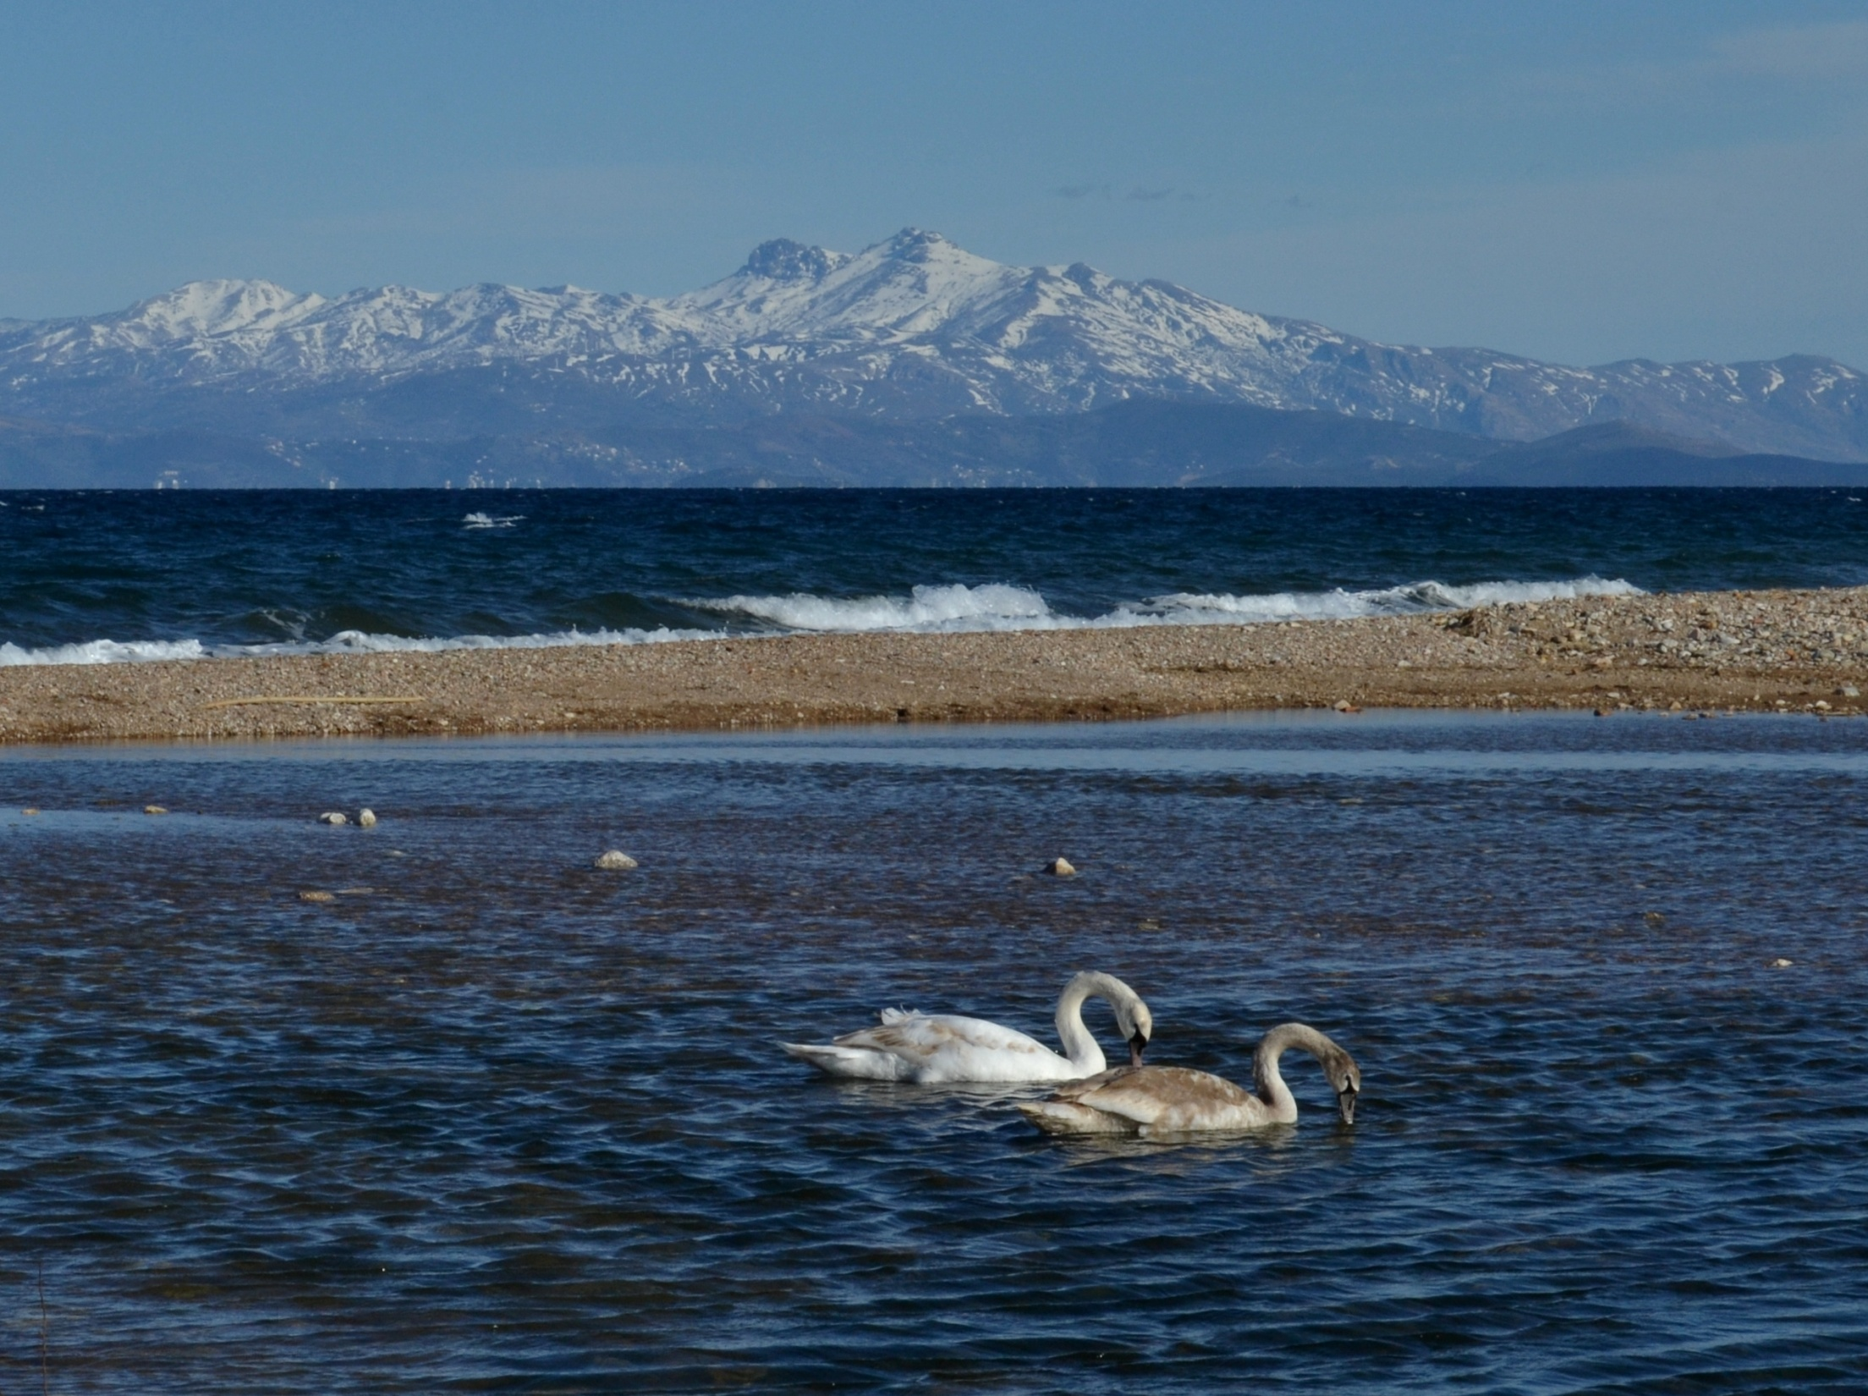
Great Rafina Stream in Great Agony

Slide 38
Don’t forget me …

Slide 39
Thank you
Grazie
Ευχαριστούμε
Gracias
Teşekkür ederim

