Slide 1
IES Miguel Espinosa
Murcia, Murcia

Slide 2
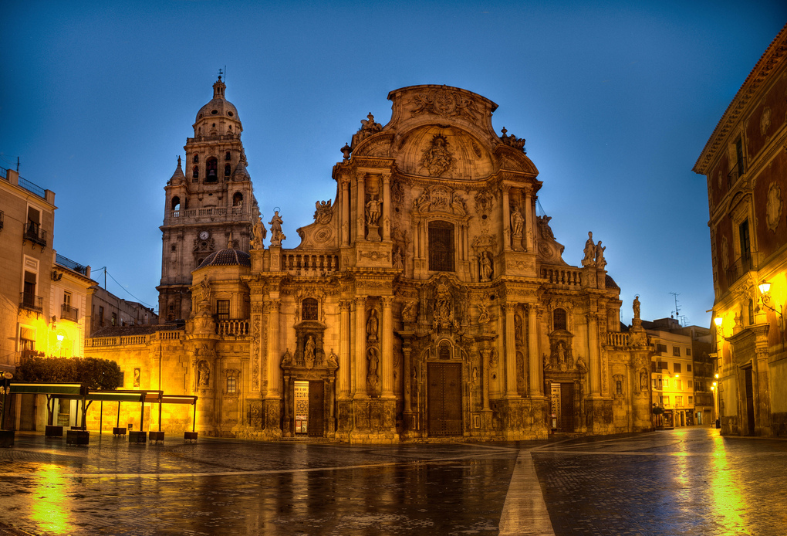
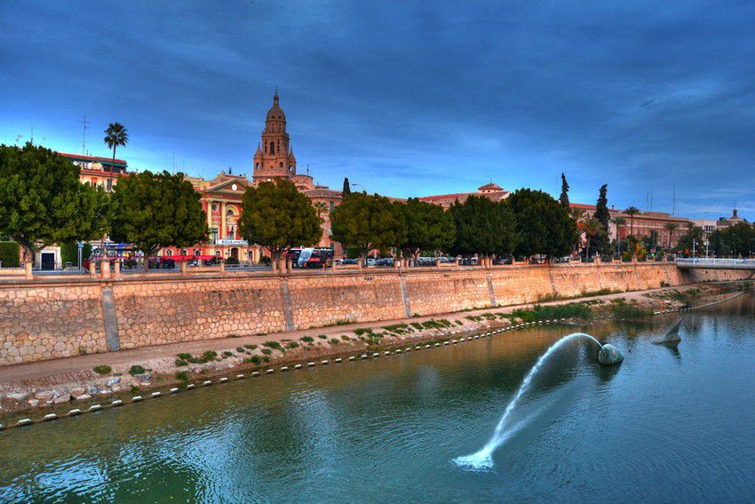
Location
The city of Murcia is located on the banks of the river Segura and it is known for its orchards.
Even though Murcia is not a very touristic city in comparison to other places in Spain, it’s still a nice city which has fascinating places to explore.
The Region of Murcia is located in the southeast of Spain between Andalusia and the Valencia Community, on the Mediterranean coast.

Slide 3
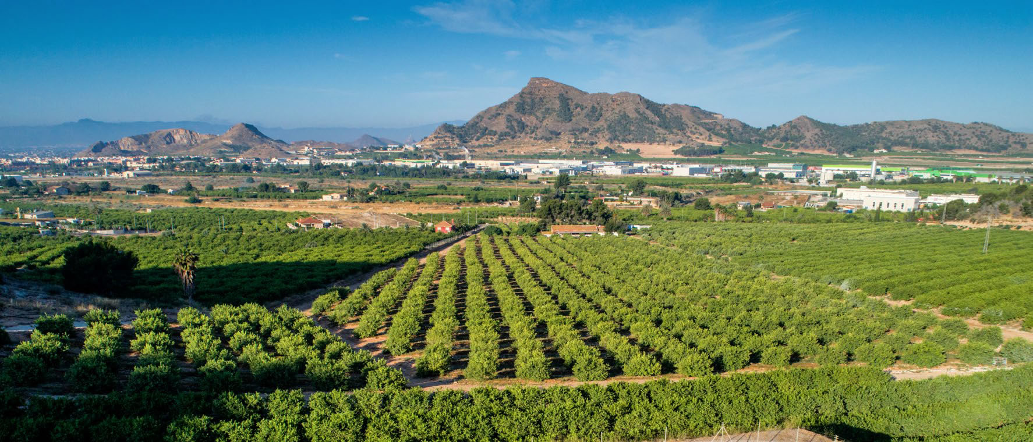
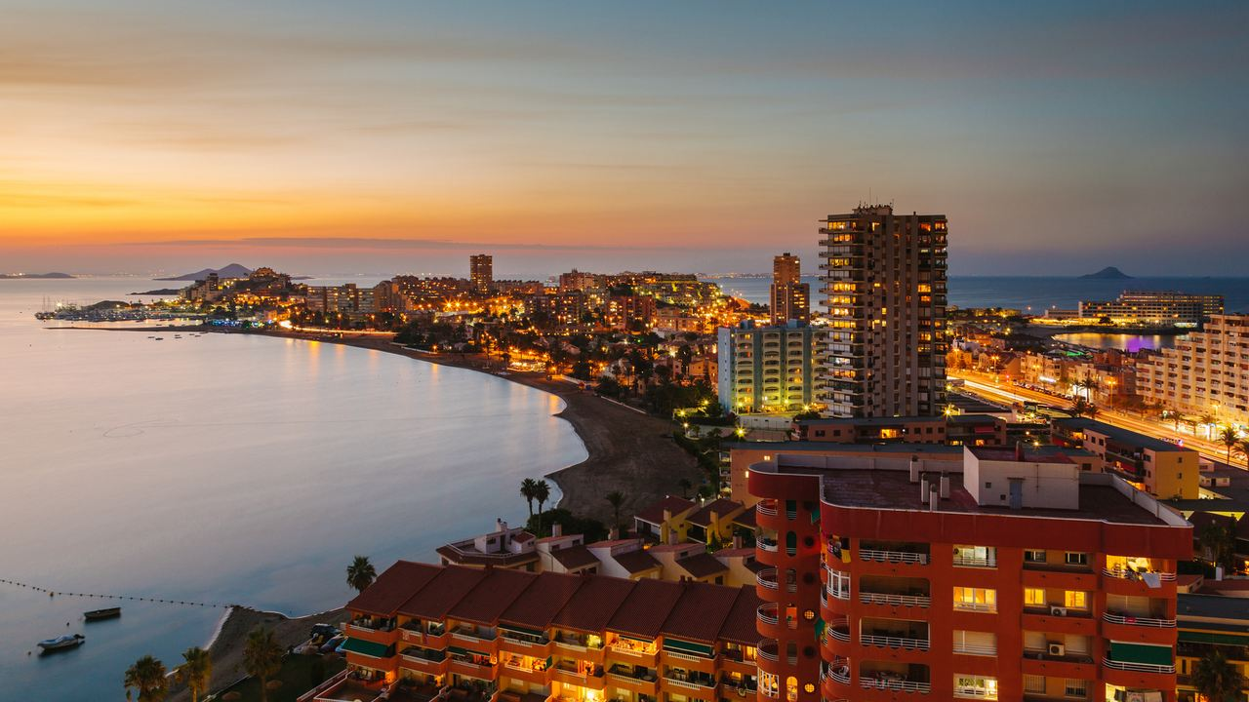
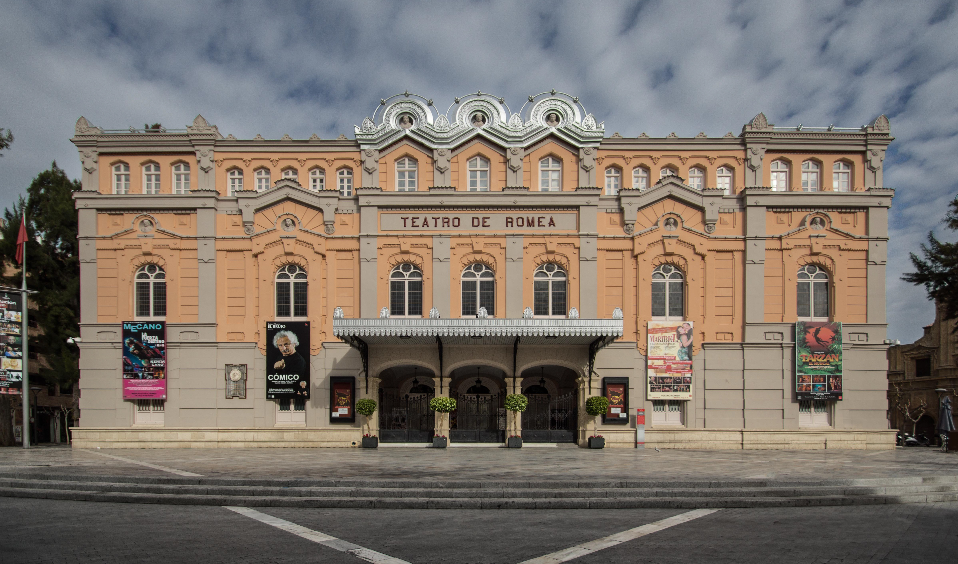
A few words about our town
We live in Murcia
Population: there is over 1,5 million of inhabitants in the Region, and in our town there are 450 thousands.
Nowadays there are many economic sectors in Murcia such as: livestock, agriculture, trade and services and, within the industrial sector, there are important industries like chemical and petrol industry.
Another activity that generates a lot of income is tourism. In the city, the main touristic attractions are the cathedral, the Romea theatre… and in the region, La Manga

Slide 4
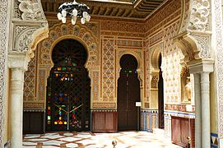
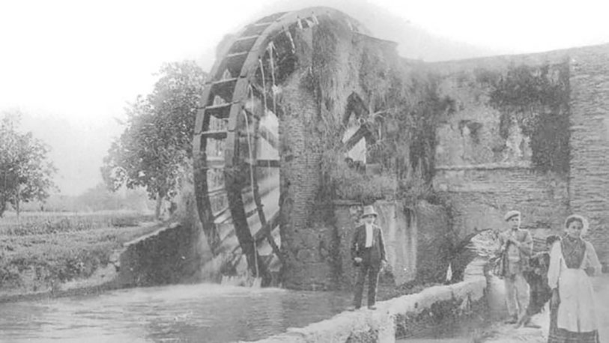
Brief history of the town:
Foundation of Murcia kingdom : 9th century by the Muslims. Their stay in the region has influenced our culture enormously.
The following period in the history of Murcia belongs to to the reign of The Wolf King, in 1147 .
The cathedral of Murcia was finished on the 24th of January of 1465.
In the last two centuries the city has been developing thanks to the orchards and the income they generate. The technological advances of the Industrial Revolution arrived to Murcia later than to other communities of Spain.

Slide 5
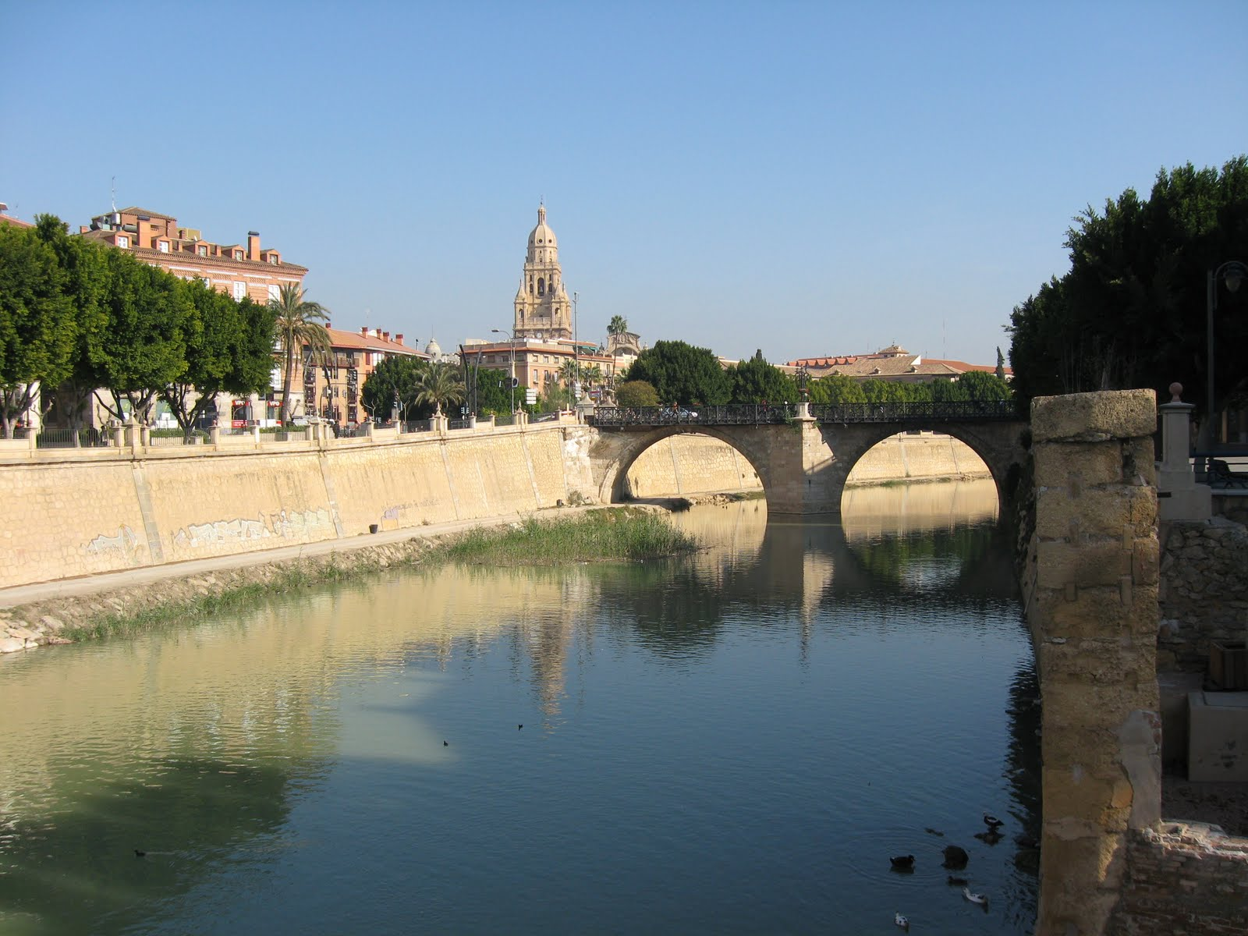
Meet our river
Our river´s name is Segura. Although it crosses our city, we are not going to focus on it, because it has less problems than other areas.

Slide 6
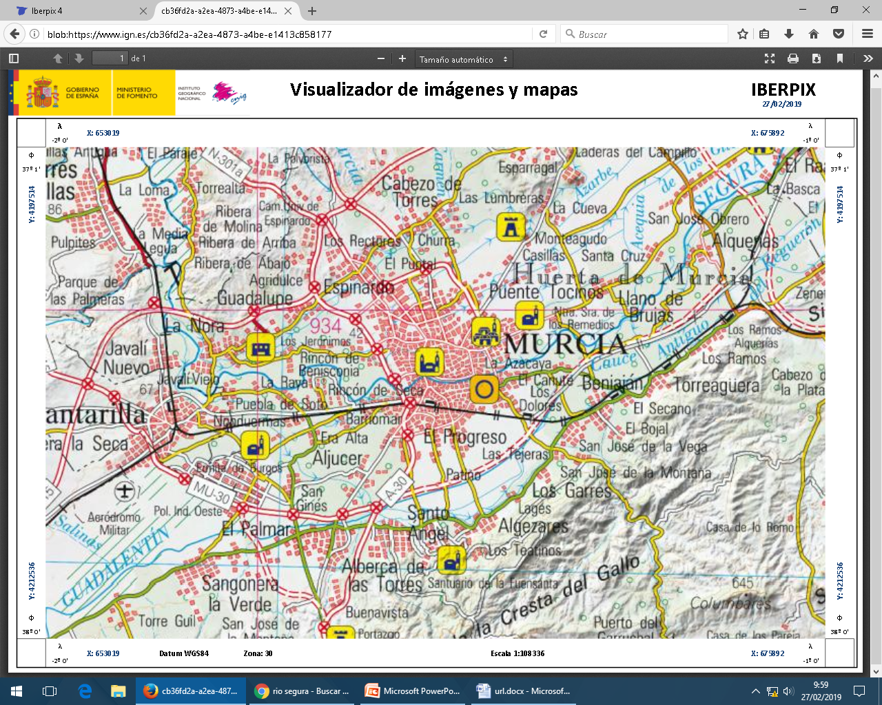
CONTRAPARADA
ESPINARDO
We are going to talk about some non permanent streams, irrigation canals and draining canals.
EL GARRUCHAL

Slide 7
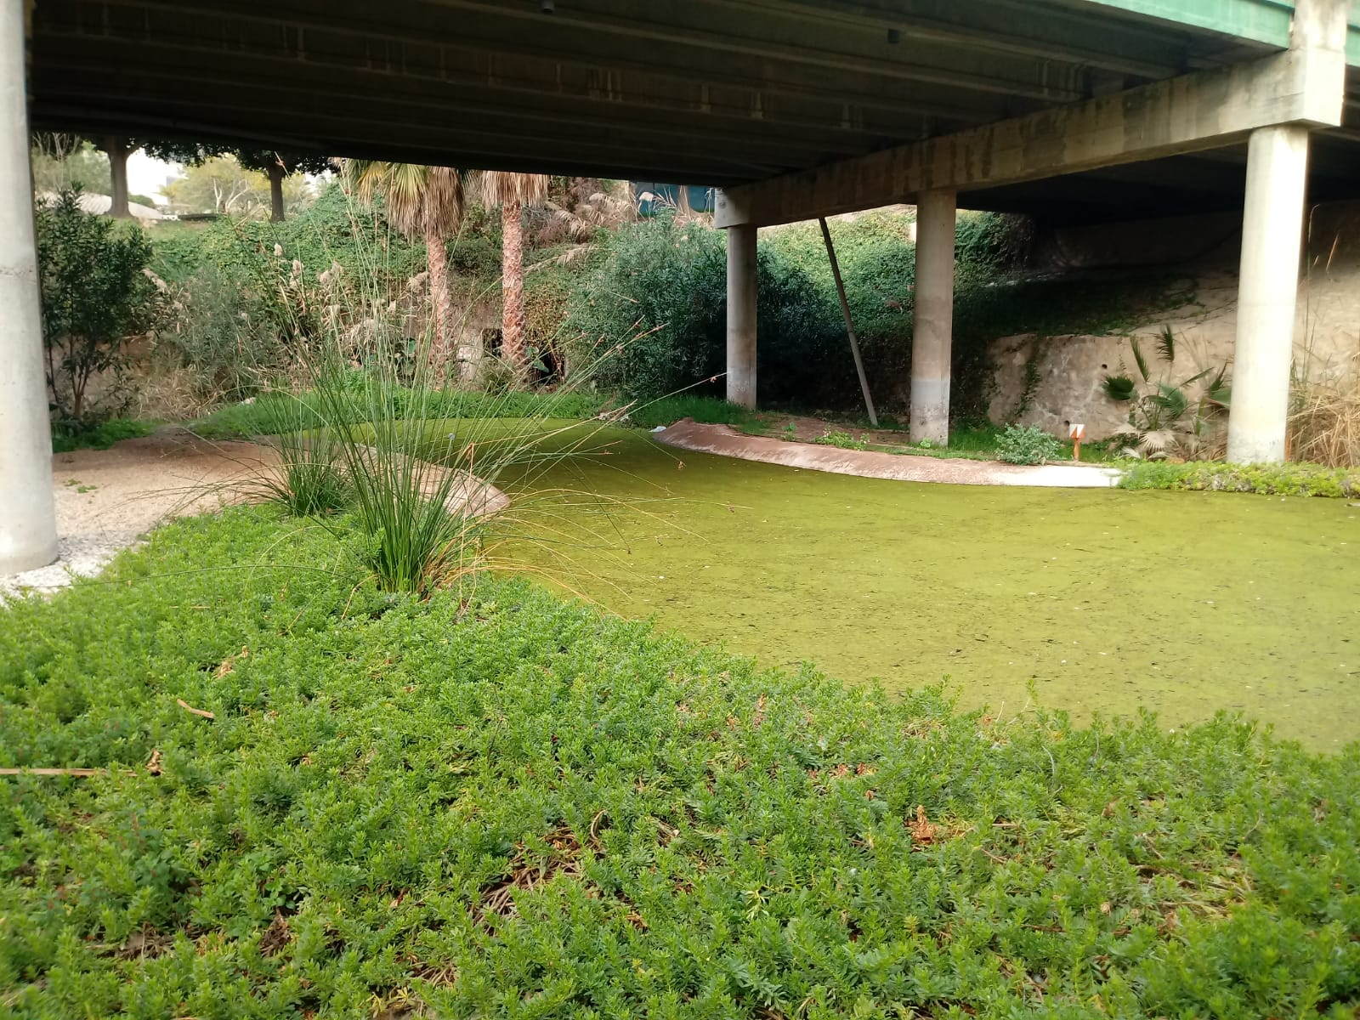
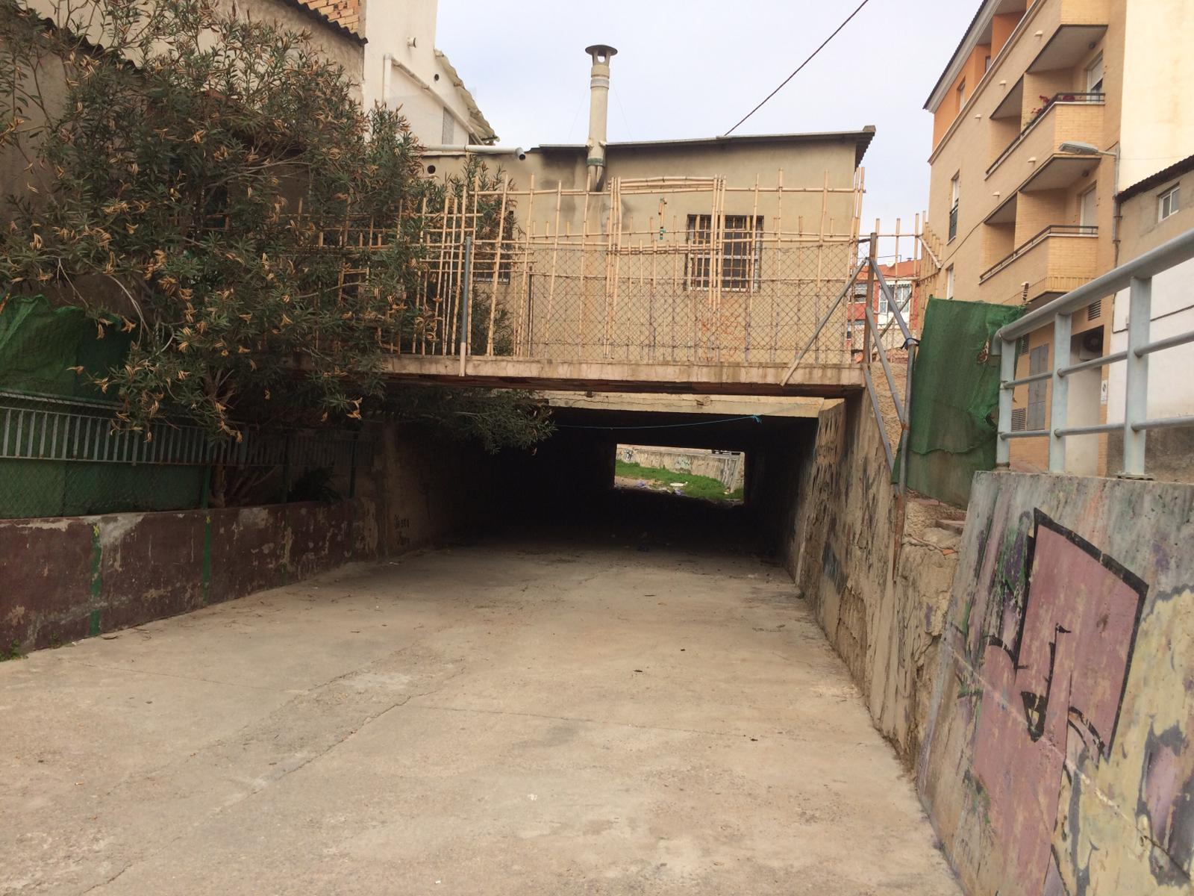
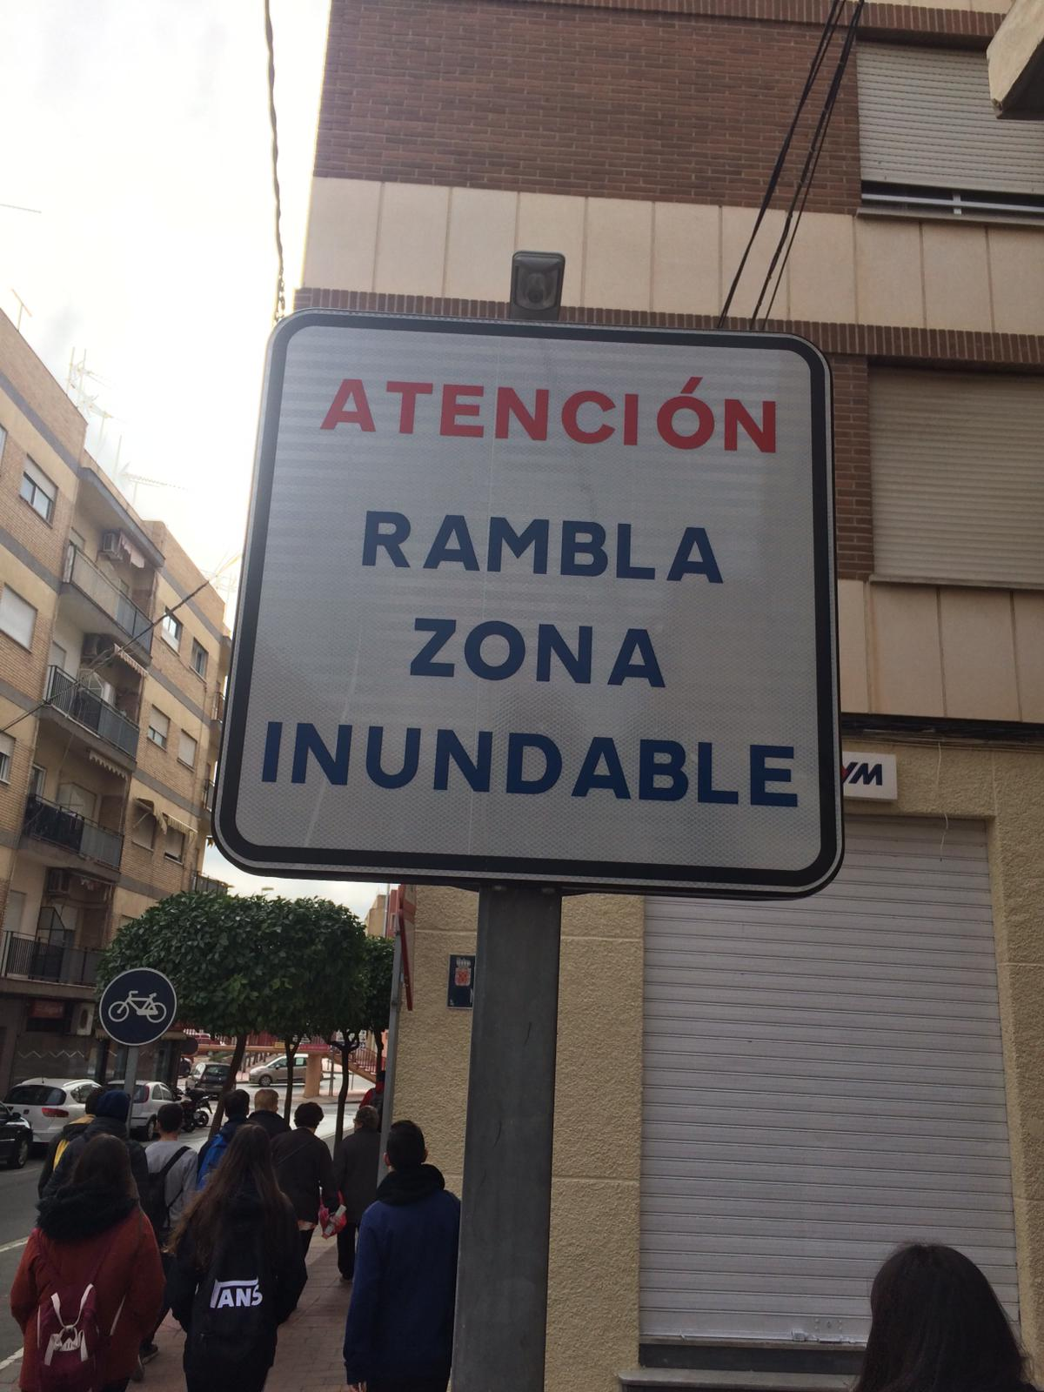
Ephemeral watercourse on urban area: Espinardo
When there are torrential rains the watercourse is flooded

Slide 8
Intermittent stream on a rural area: Garruchal
El Garruchal is one of the three natural passes that exist in the chain of mountains that closes the valley of the Segura River in the south.
This stream carries water seasonally, usually, from autumn to spring.

Slide 9
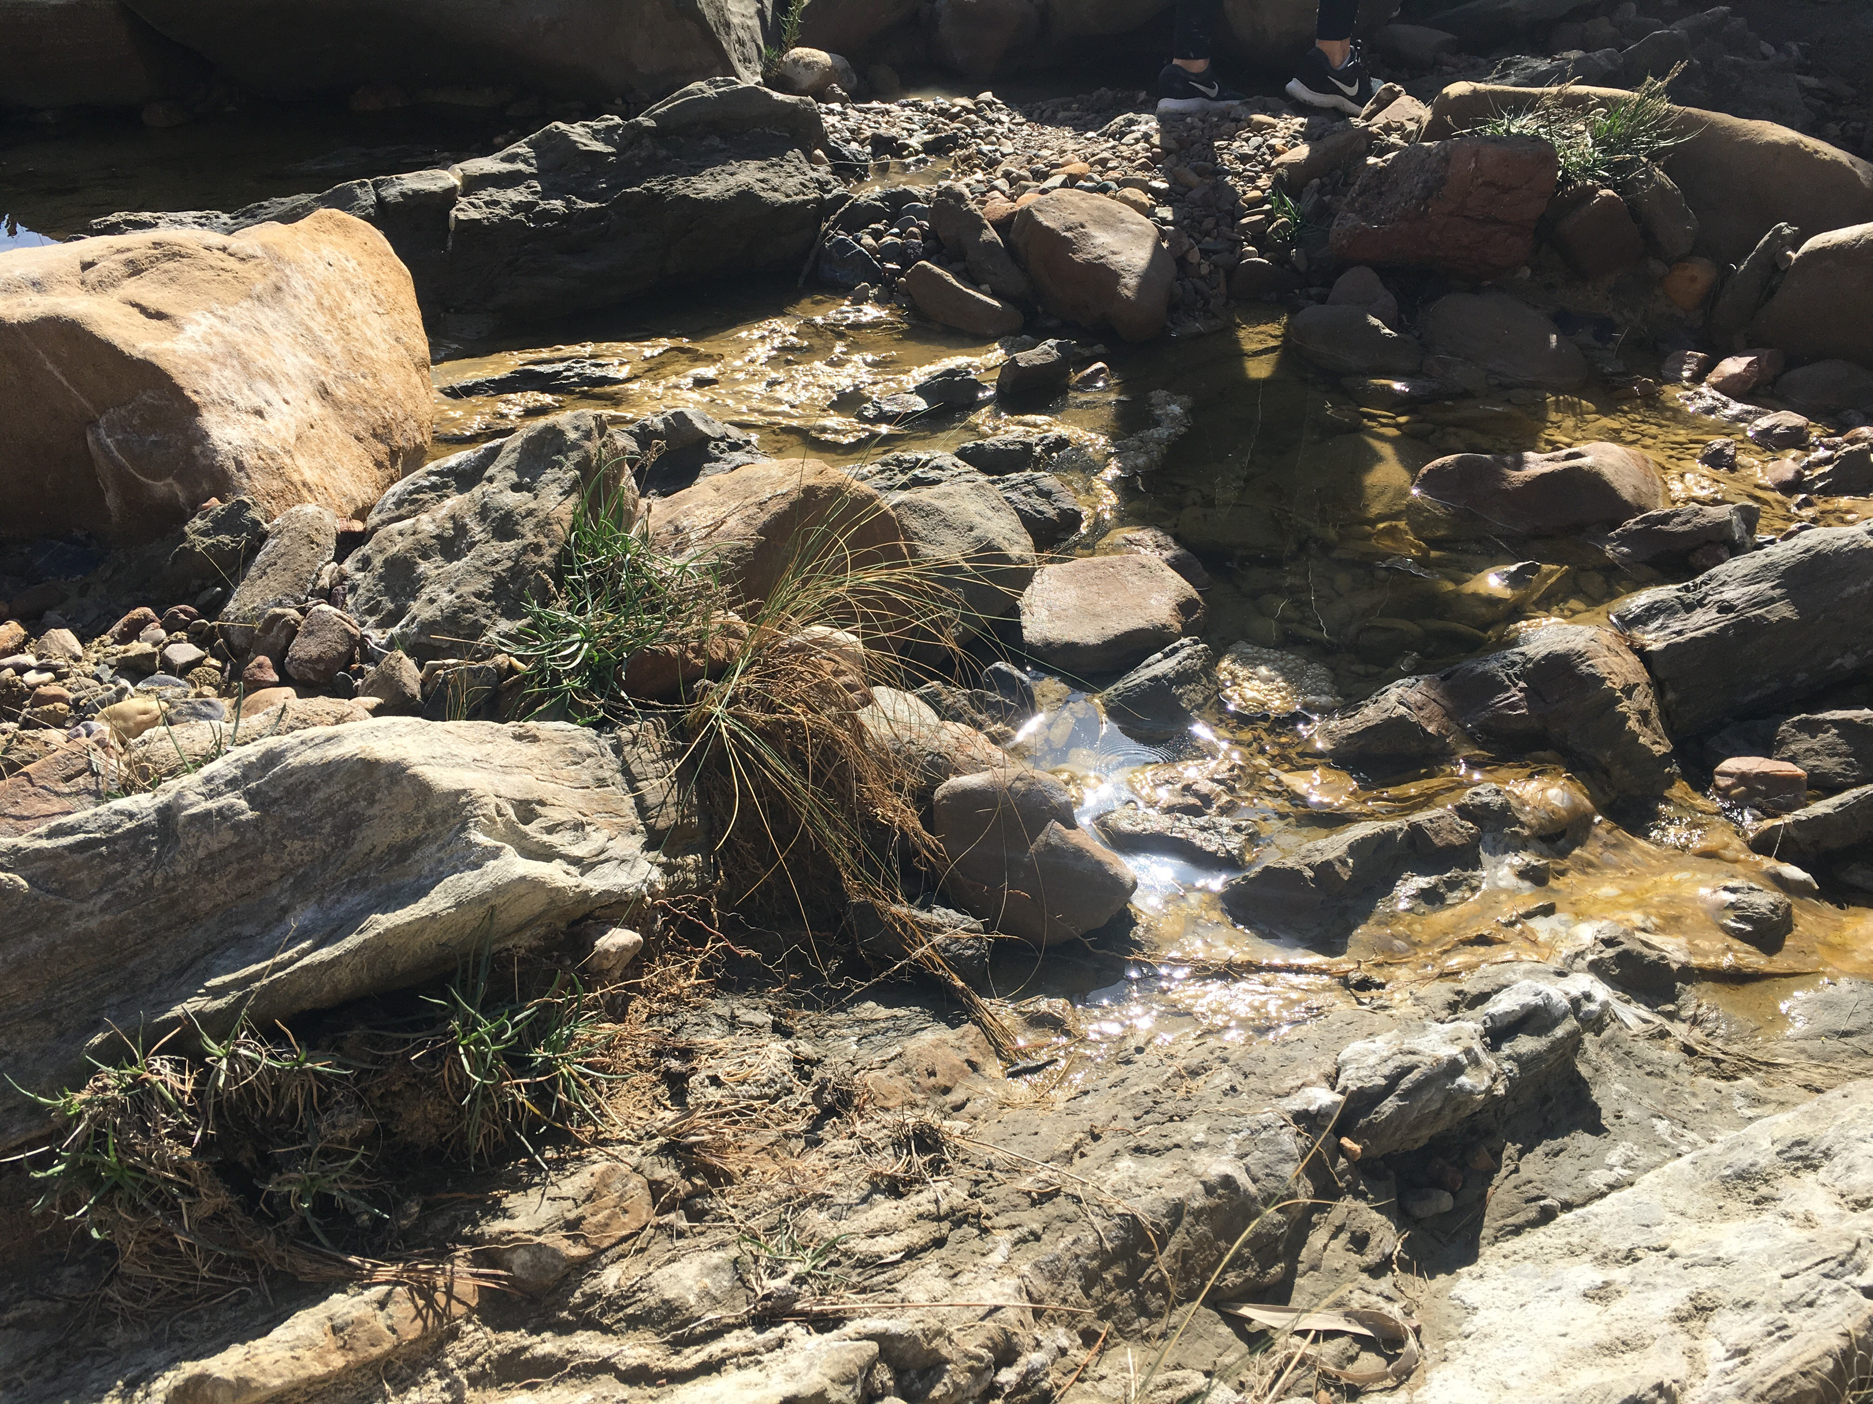
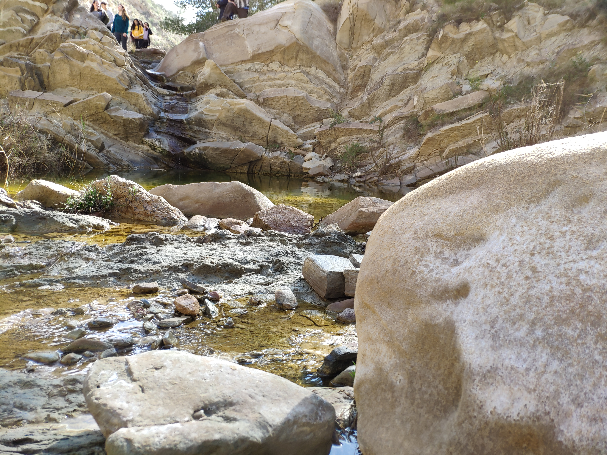
Photos about our visit to Garruchal
The water is very salty

Slide 10
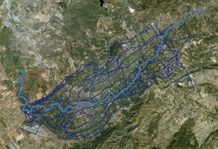
Irrigation and draining canals (water taken from the river in Contraparada)
The water is diverted from the river to irrigation canals which form a dense network taking water to the orchards.

Slide 11
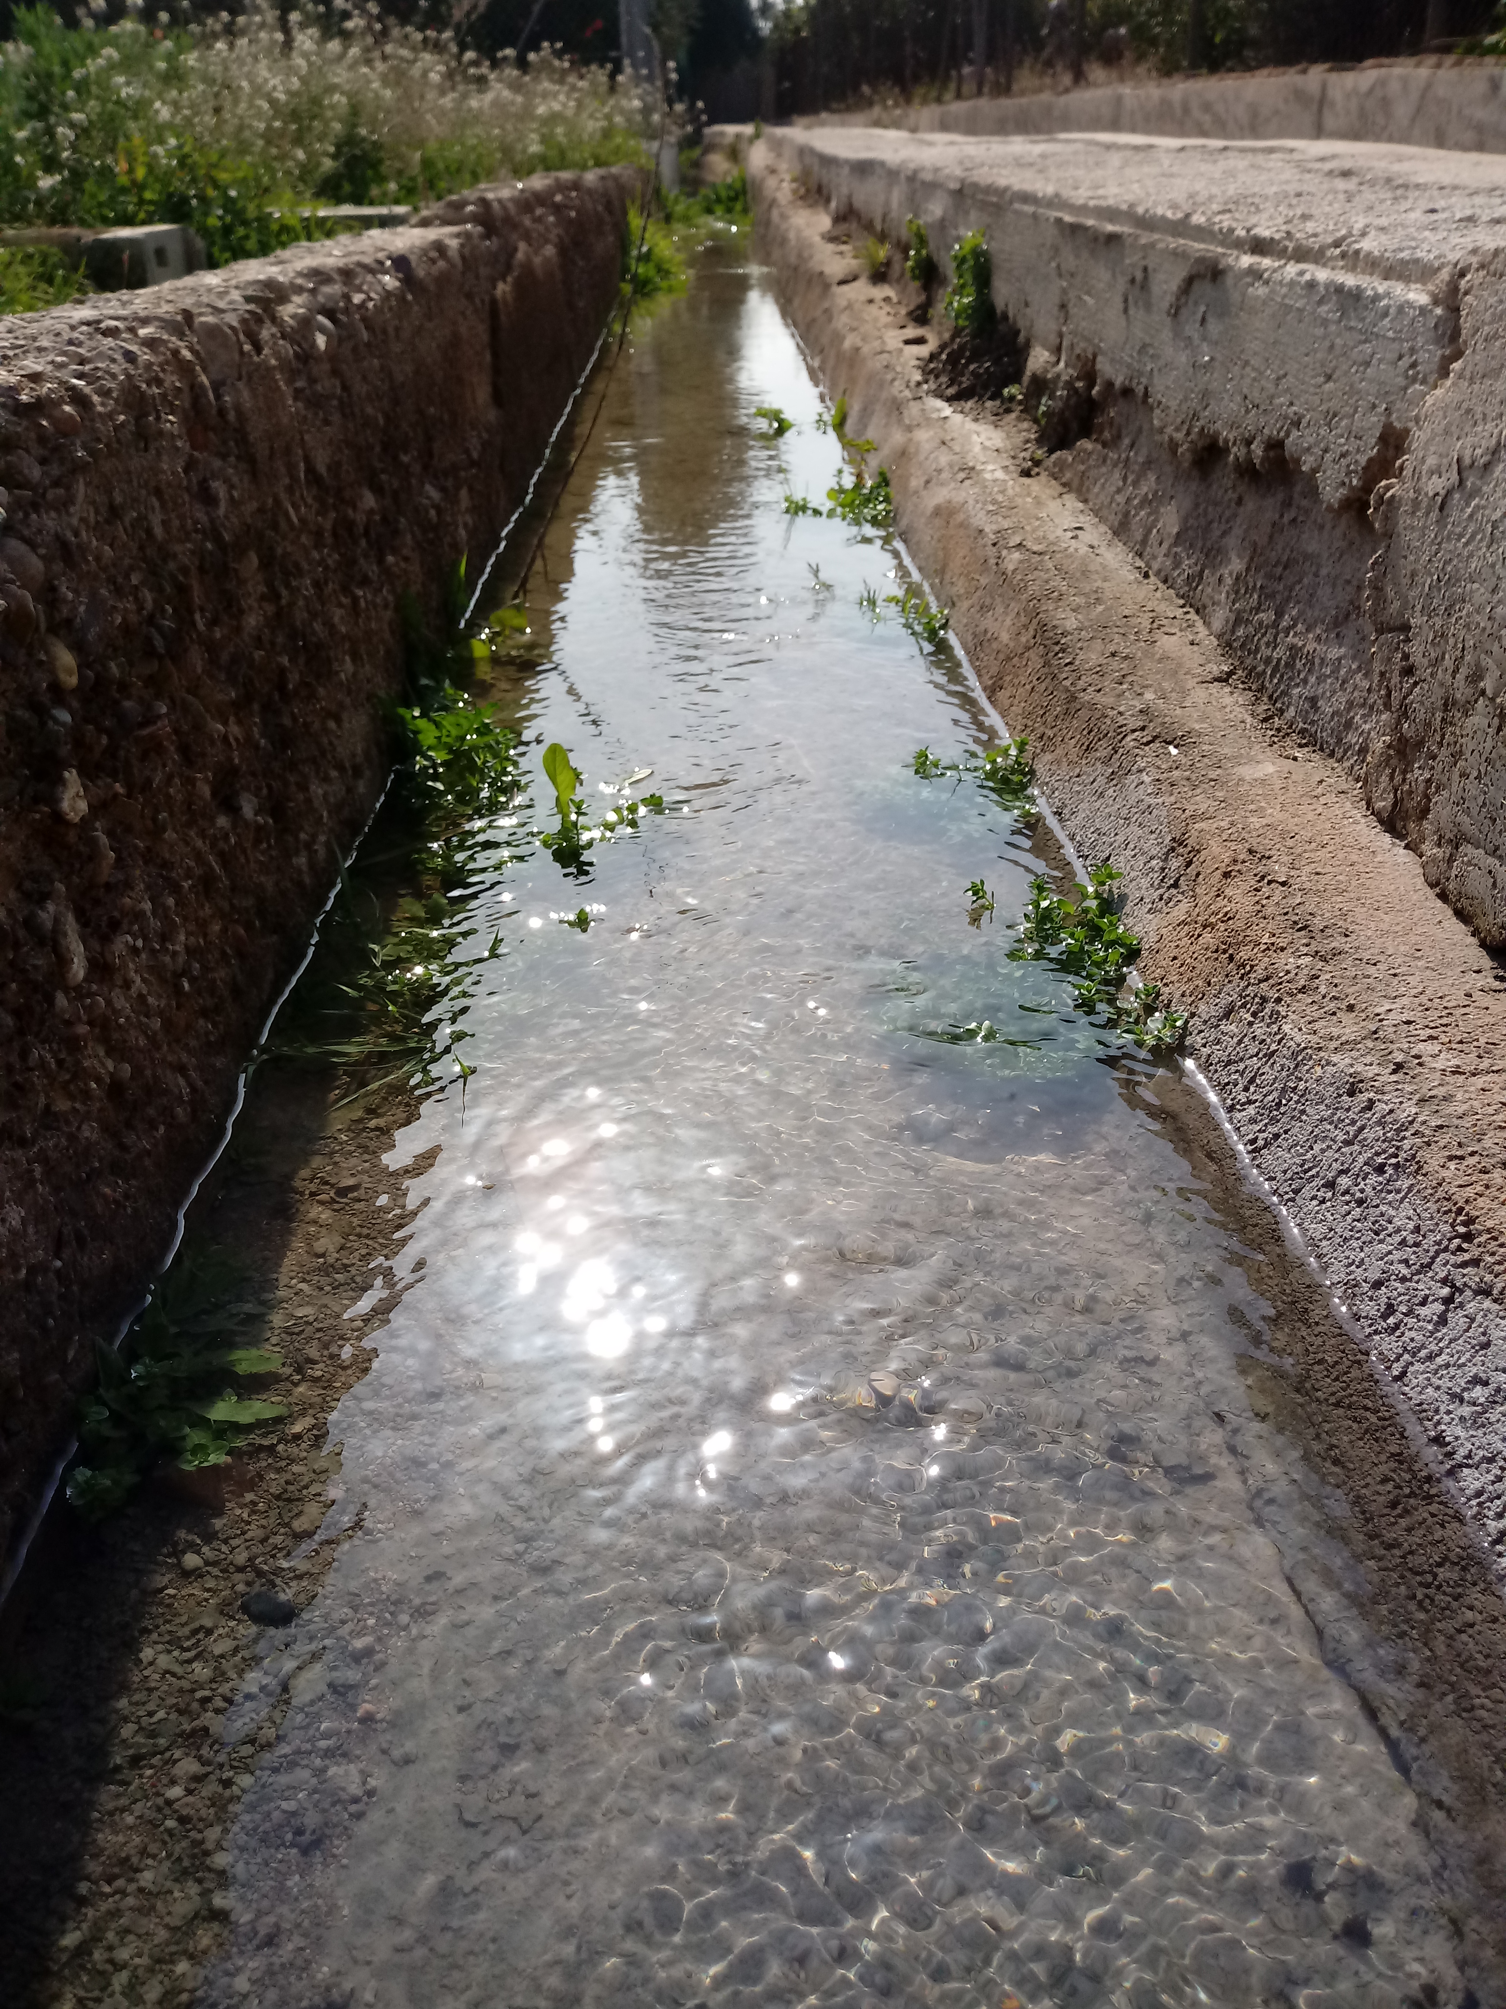
Irrigation canals (acequias)
The water comes directly from the river and is used to water the orchards.

Slide 12
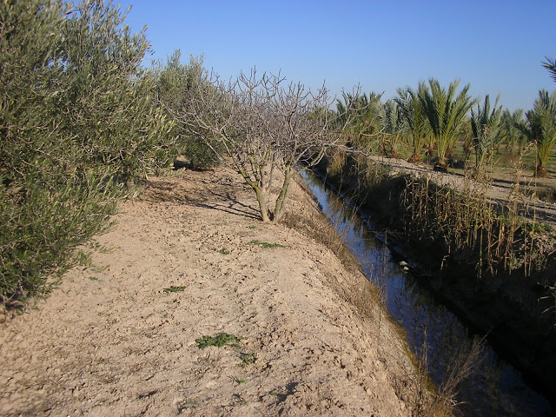
Draining canals (azarbes)
The overflowing water from irrigation is filtrated and discharged into the azarbes. This water is drained and used for other purposes.

Slide 13
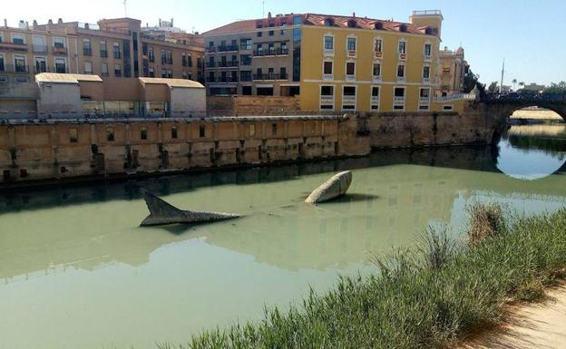
Problems on our study site
The water of the main river, Segura, isn’t polluted because the water is well depurated.
By contrast the water of the azarbes is polluted due to the fact that it contains rests of the fertilizers used in orchards

Slide 14
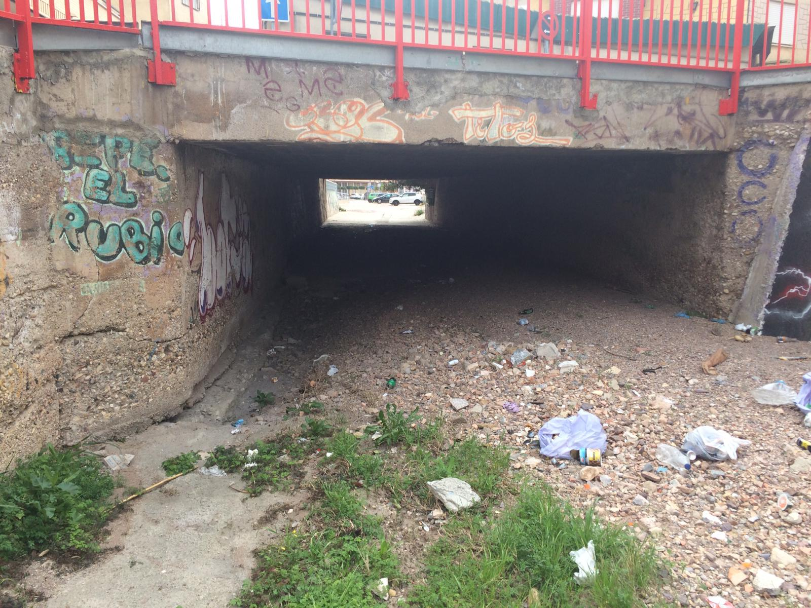
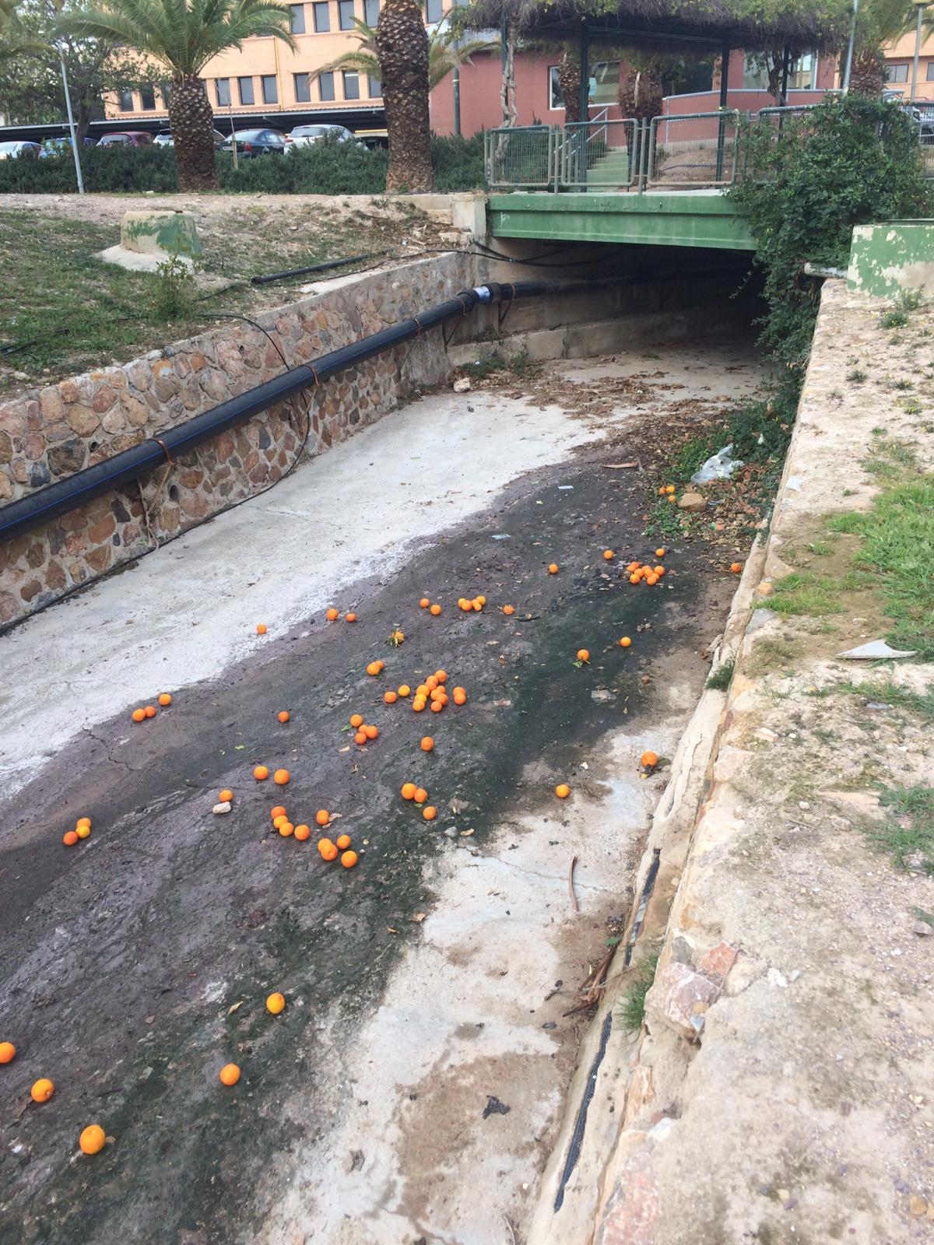
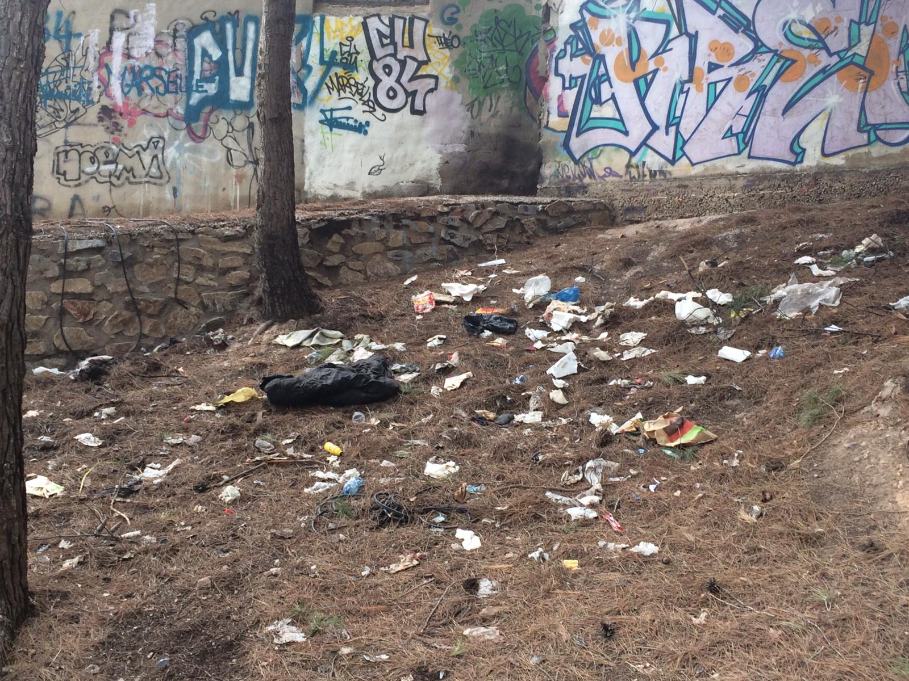
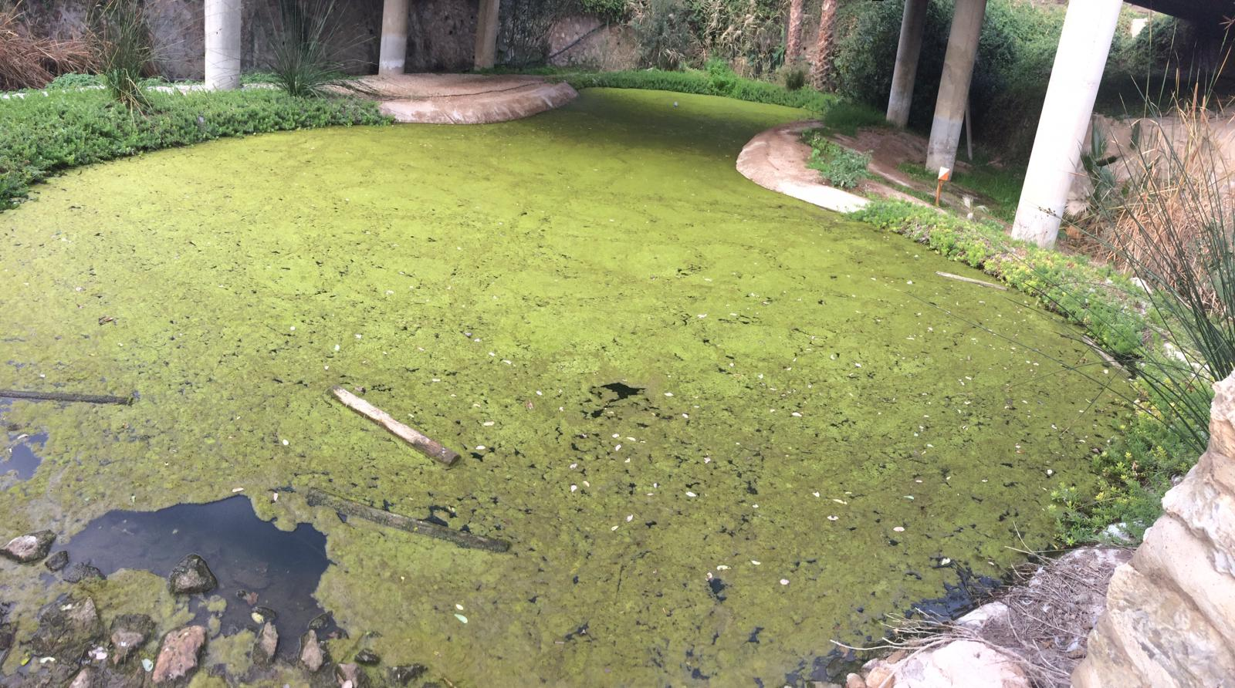
Main issues of our streams (ramblas)
Waste materials
Espinardo´s water course

Slide 15
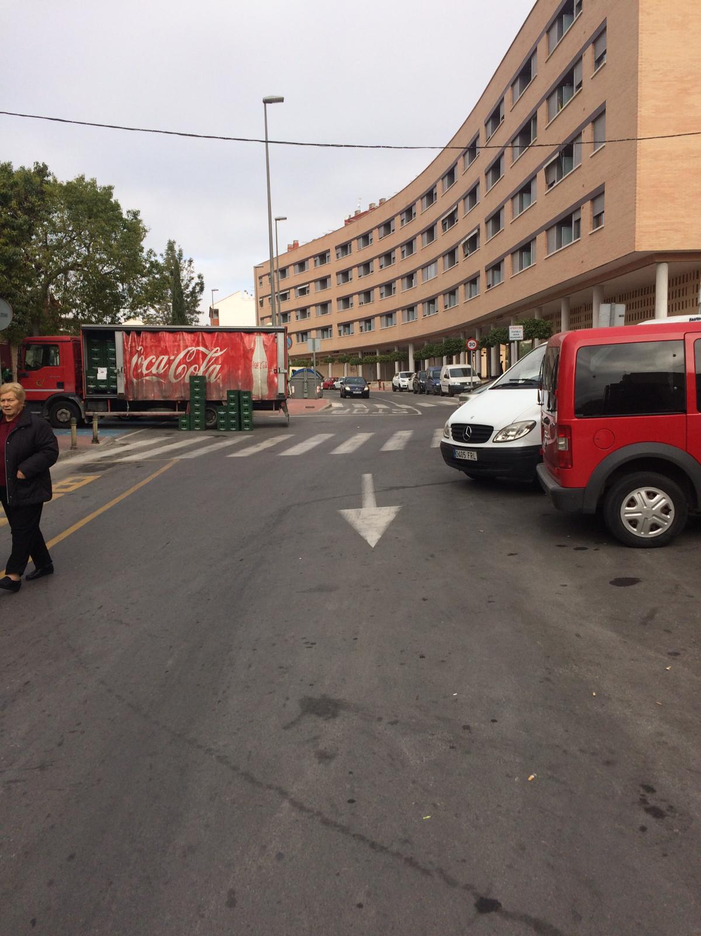
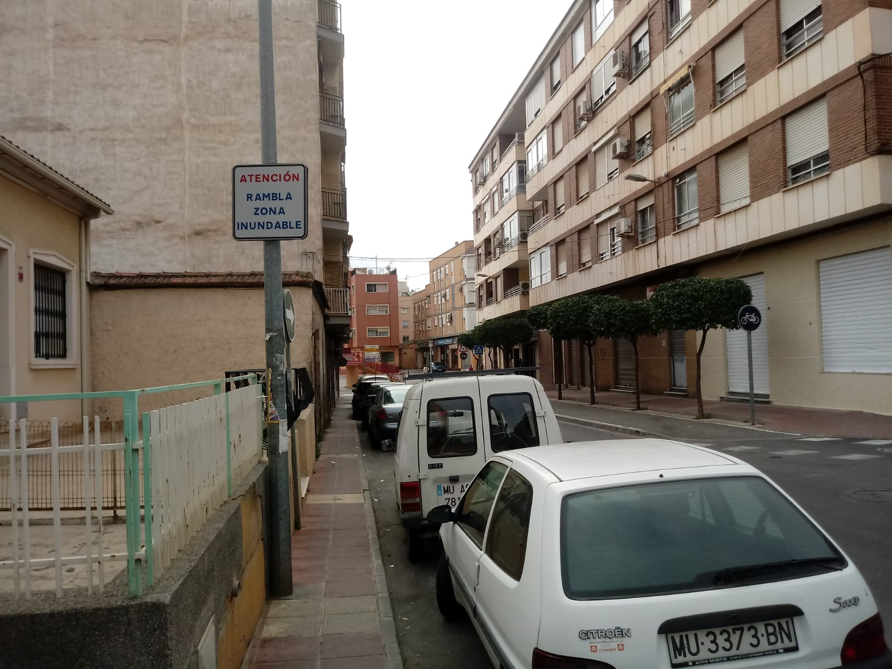
Urban planning problems
WARNING:
Stream
flooding area
Street is the ¡¡stream!!!
These zones get flooded during the periods of rain because the town has grown without an appropriate urban planning.

Slide 16
Thank you
Grazie
Ευχαριστούμε
Teşekkür ederim
Gracias

